Slide 1
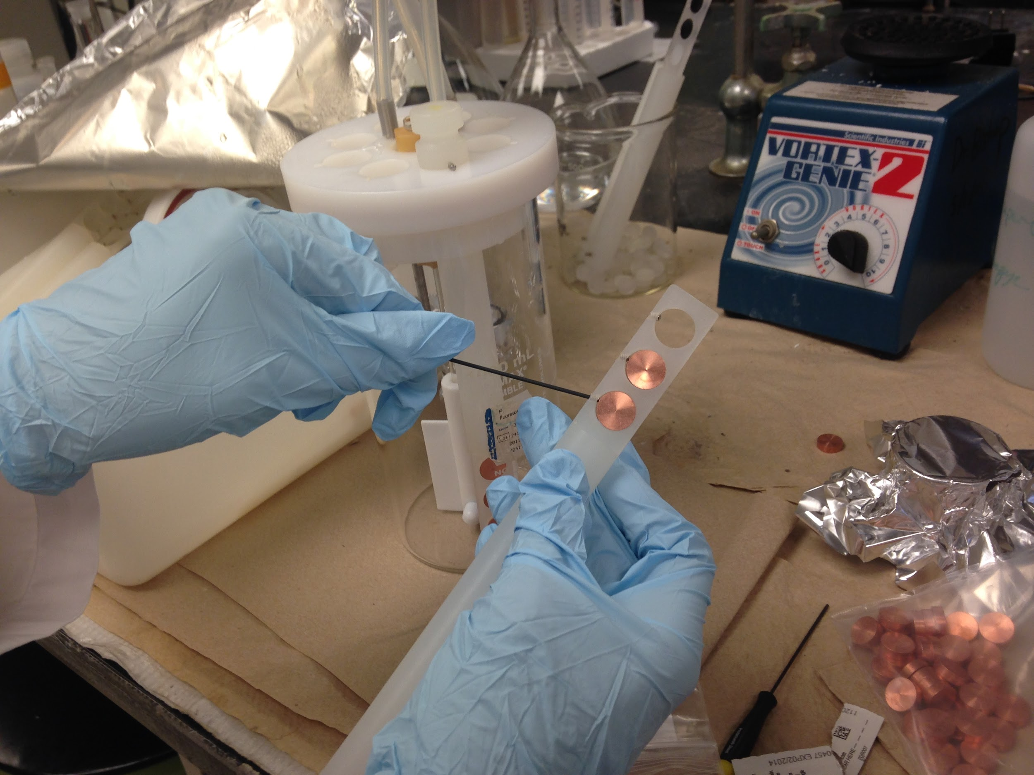
Application of Nanocomposites on Controlling Biofilms in Drinking Water Distribution System RET Group Presentation
The RET program funded by the National Science Foundation, Grant ID# EEC-1404766
Amy Parker, Environmental Science, Finneytown High School
Nancy Vossen, Biology, William Henry Harrison High School

Slide 2
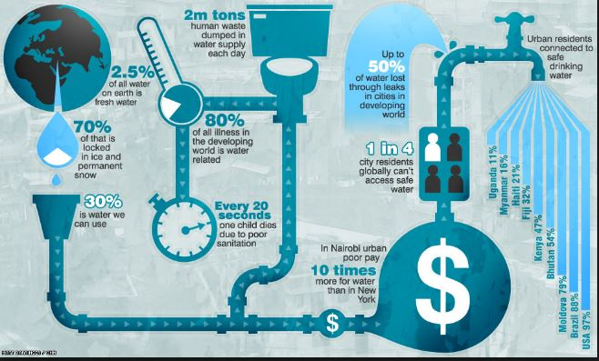
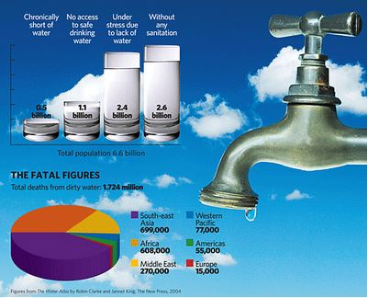
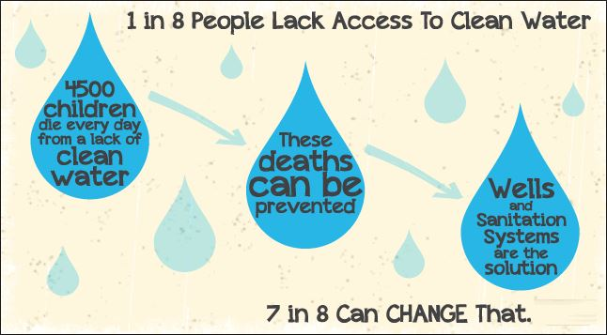
Why Should You Care??
magic.piktochart.com
http://4.bp.blogspot.com/-W4dH6JRoCL8/T12RlQeI5eI/AAAAAAAAAhQ/AtDRk4jFv10/s1600/water+shortage+data.png
www.dropinthebucket.org

Slide 3
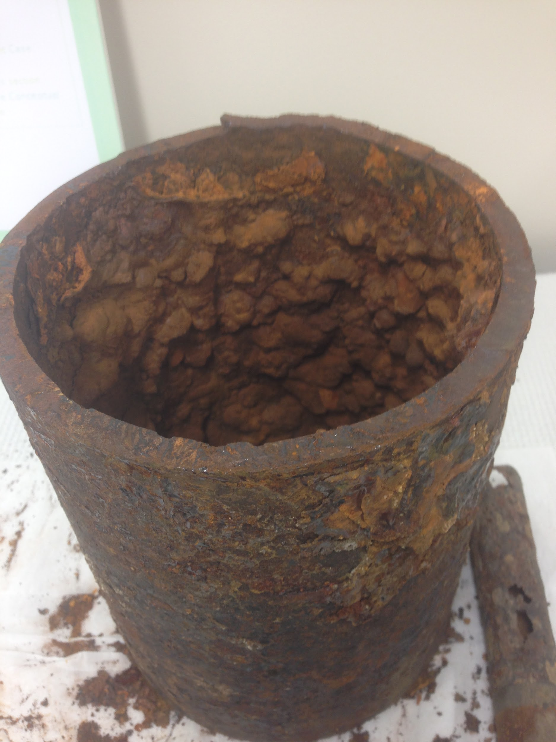
Table of Contents
Abstract / Introduction
Background Literature Review
Goals and Objectives
Tasks to be Undertaken
Timeline
Research Training
Progress Made
Unit Progress
References

Slide 4
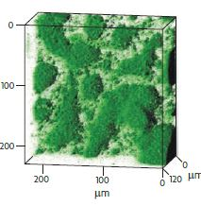
Introduction / Abstract
Biofilms; positives and negatives
Biofilm in the water distribution system
Public health risk
Prevention
Nanotechnology as method of prevention
Investigate alternative pipe materials
Carbon nanotubes and polymer nanocomposites
Biofilm reactor and LSM
Flemming and Wingender, 2010

Slide 5
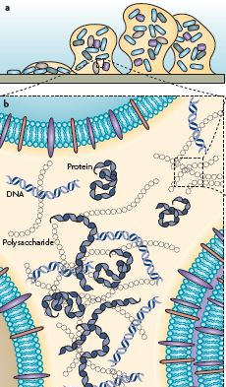
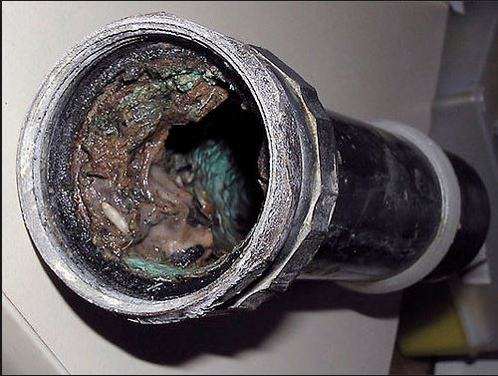
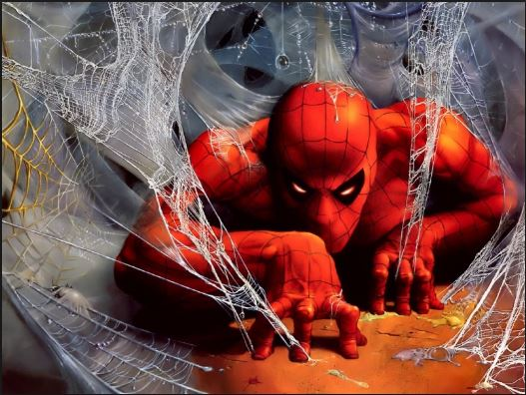
Background Literature Review
Biofilm
Grow naturally in nature
Bacteria clump and attach to surface
Embedded in an Extracellular Polymeric Substance (EPS)
proteins, polysaccharides, nucleic acids, and lipids.
Aids in adhesion-cohesion, provide nutrients, and stability
www.biofilm.montana.edu
Flemming, H., and Wingender, J. (2010).
http://comicvine.gamespot.com/forums/battles-7/spider-man-runs-the-gaunlet-592026/
Notes:
Positive: Human gut, Sand filtration, Waste water treatment,“Self-purification” in natural environment.
Negative: Dental biofilms, Ship hulls, Other health issues, Reduce quality of drinking water, Pipe corrosion, Protect pathogens and viruses

Slide 6
Possible Solutions for Biofilm Control in Water Distribution System
Current research:
Nanocomposites - using Carbon Nanotubes (CNTs)
Method | Limitations
Chlorine | Corrosion and carcinogenic by products
Pipe materials | Cost, availability, lifespan
Prevent / Minimize Stagnant Water | Difficult to control

Slide 7
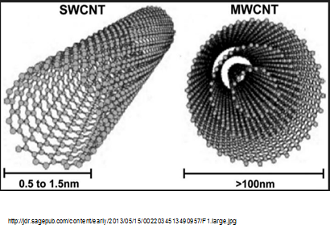
Carbon Nanotubes (CNTs)
Carbon Nanotubes (CNTs)
Nanoscale in size
Benefits of Use:
Crystalline structure
High surface area
Inactivate pathogens
Effectiveness
Dispersal
Stability

Slide 8
3 Applications of CNTs
Suspensions and coatings have limitations
Polyethylene Multiwalled Carbon Nanotubes (PE-MWCNTs) Composites
Suspension | Coating | Nanocomposites
Result in aggregation | Eventually slough off | Completely new material

Slide 9
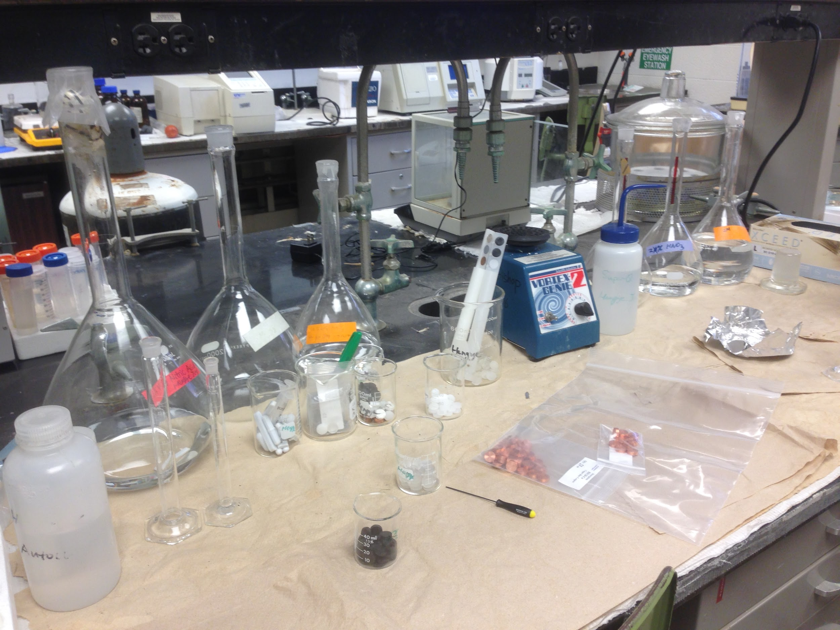
Goals
G1. Understand the impact of biofilms on the quality of drinking water.
G2. Investigate the influence of surface properties of nanomaterials in the prevention of biofilm growth.
G3. Discover the relationship between research in academia and concepts taught in today’s classroom.

Slide 10
Objectives
O1. Establish and maintain two biofilm reactors (one with copper to serve as a control, the other with PE-MWCNTs).
O2. Use a Laser Scanning Microscope (LSM) to track biofilm growth over the time and compare the impact of two different materials on it.
O3. Utilize JMPⓇ statistical analysis software on data collected to determine the impact of surface properties on bacterial growth.
Notes:
“Nancy will now explain the research tasks….”

Slide 11
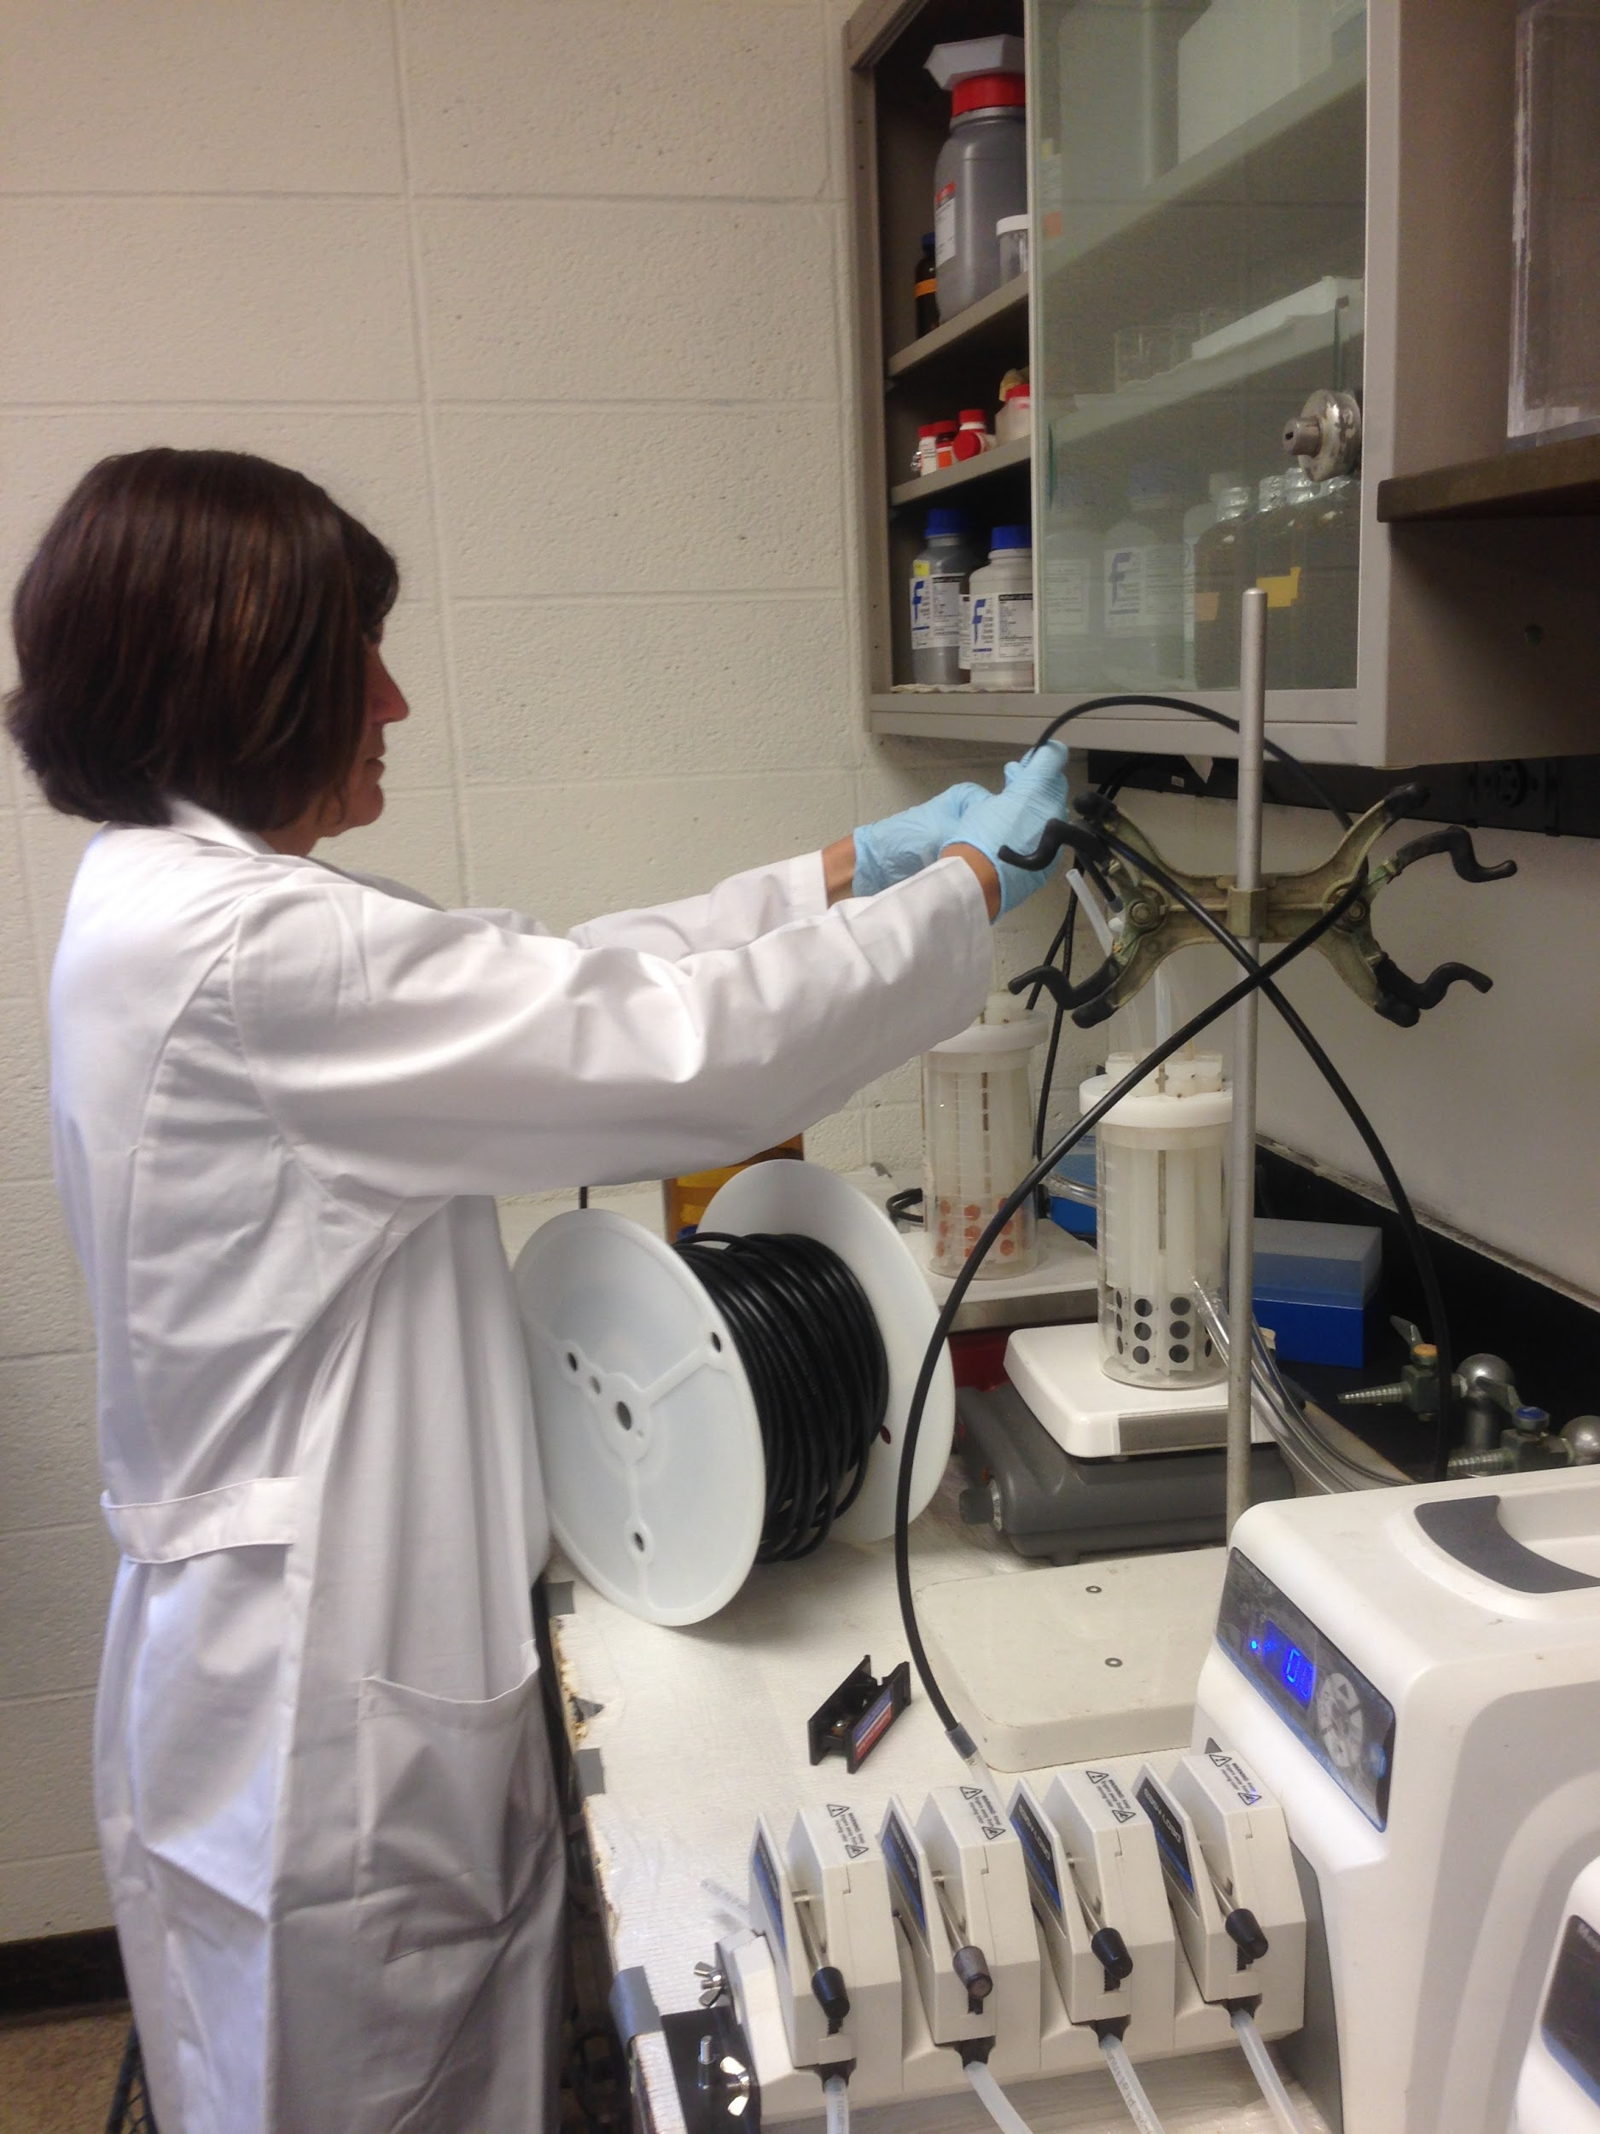
Research Tasks
Literature Review (G1)
Running Biofilm Reactor (G1, O1)
LSM Analysis (G2, O2)
Surface Characterization Study (G2, O3)
Statistical Analysis JMPⓇ (G2, O3)

Slide 12
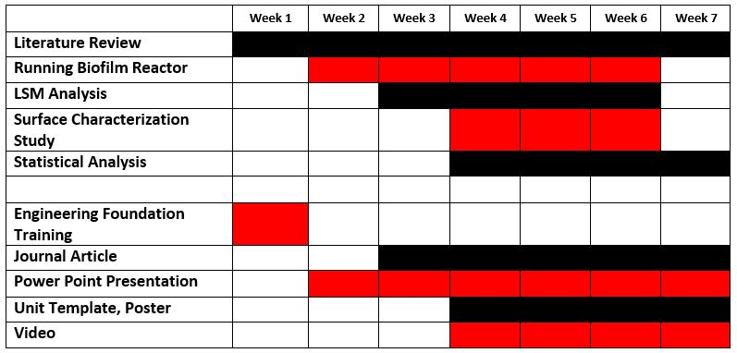
Timeline
Notes:
Our timeline was divided into research tasks and RET deliverable expectations.

Slide 13
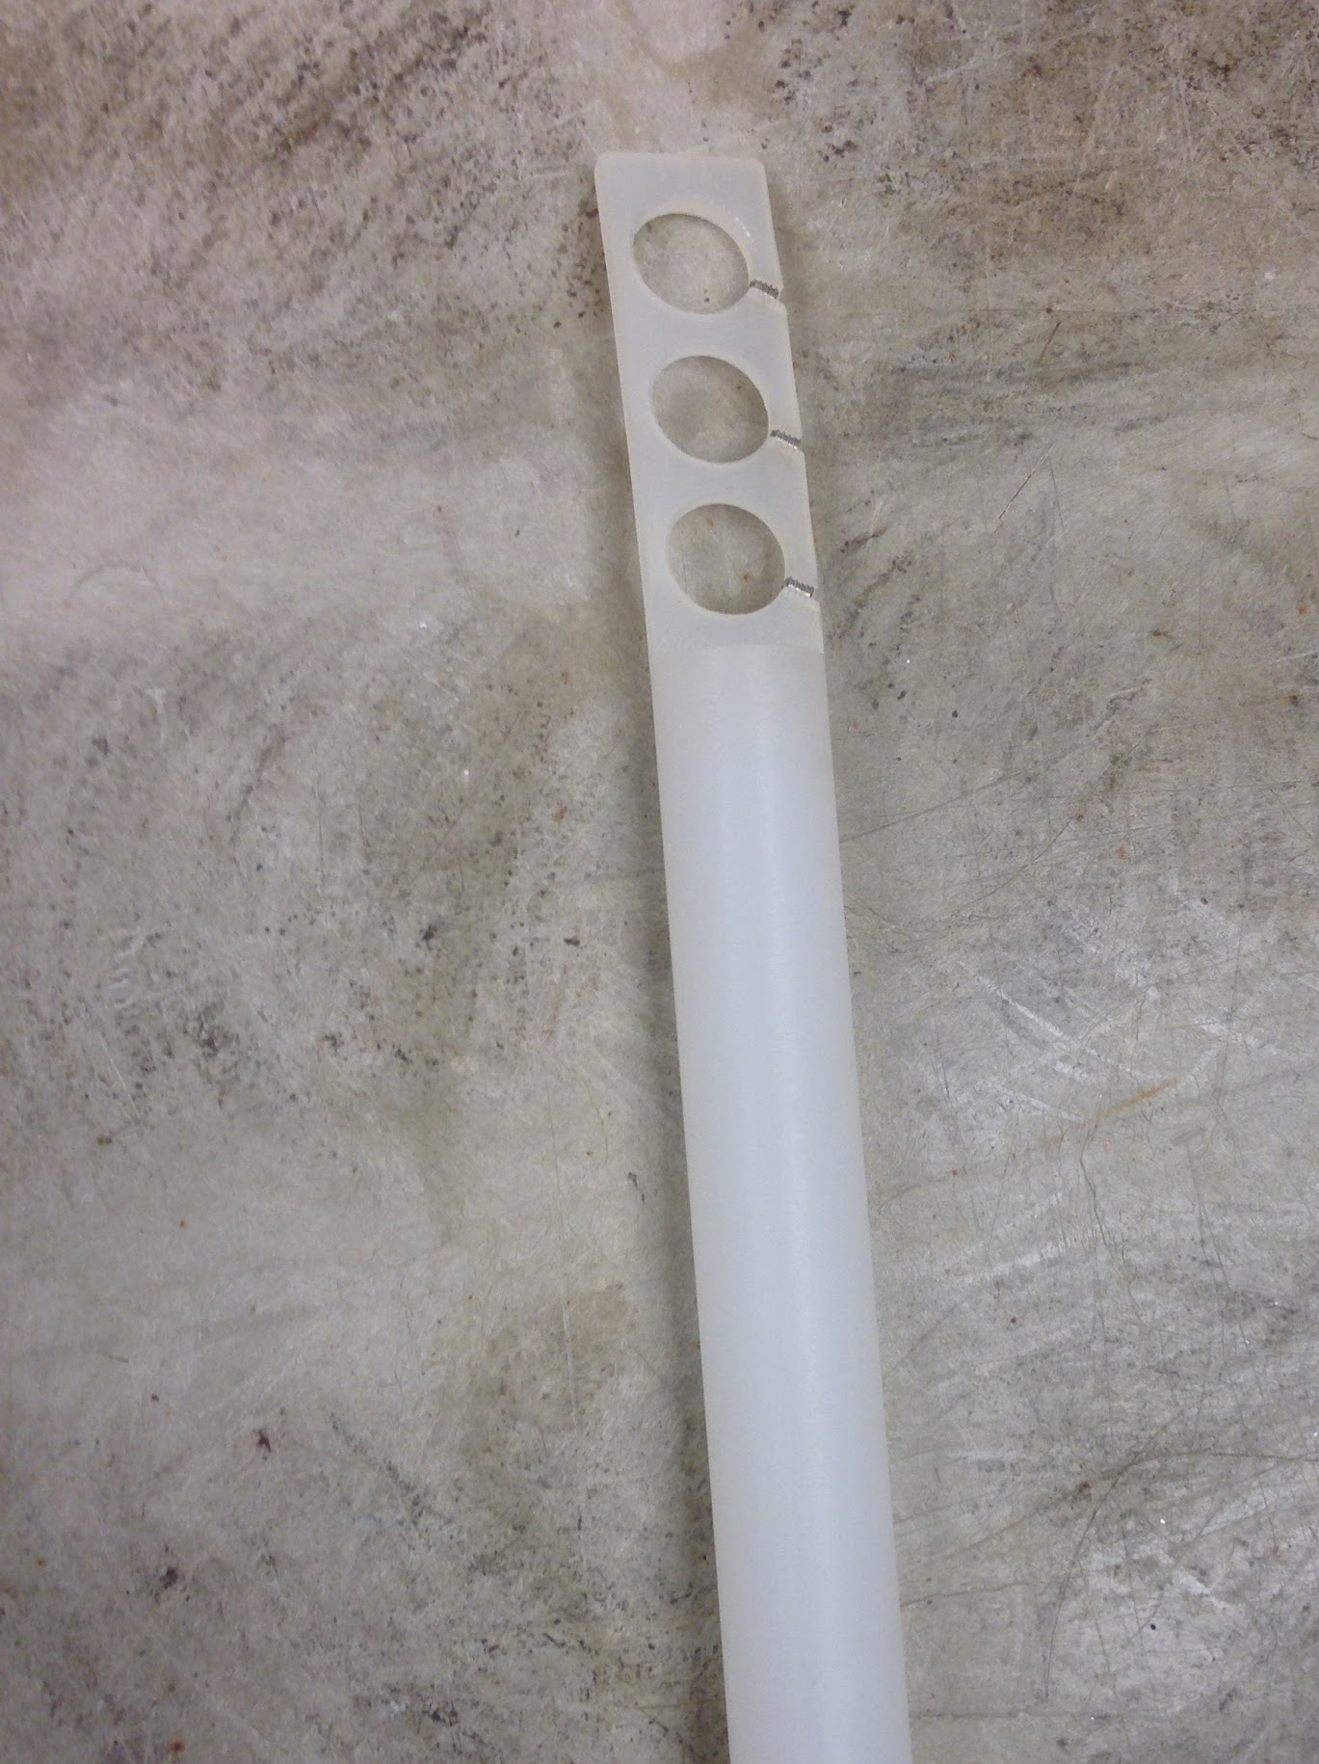
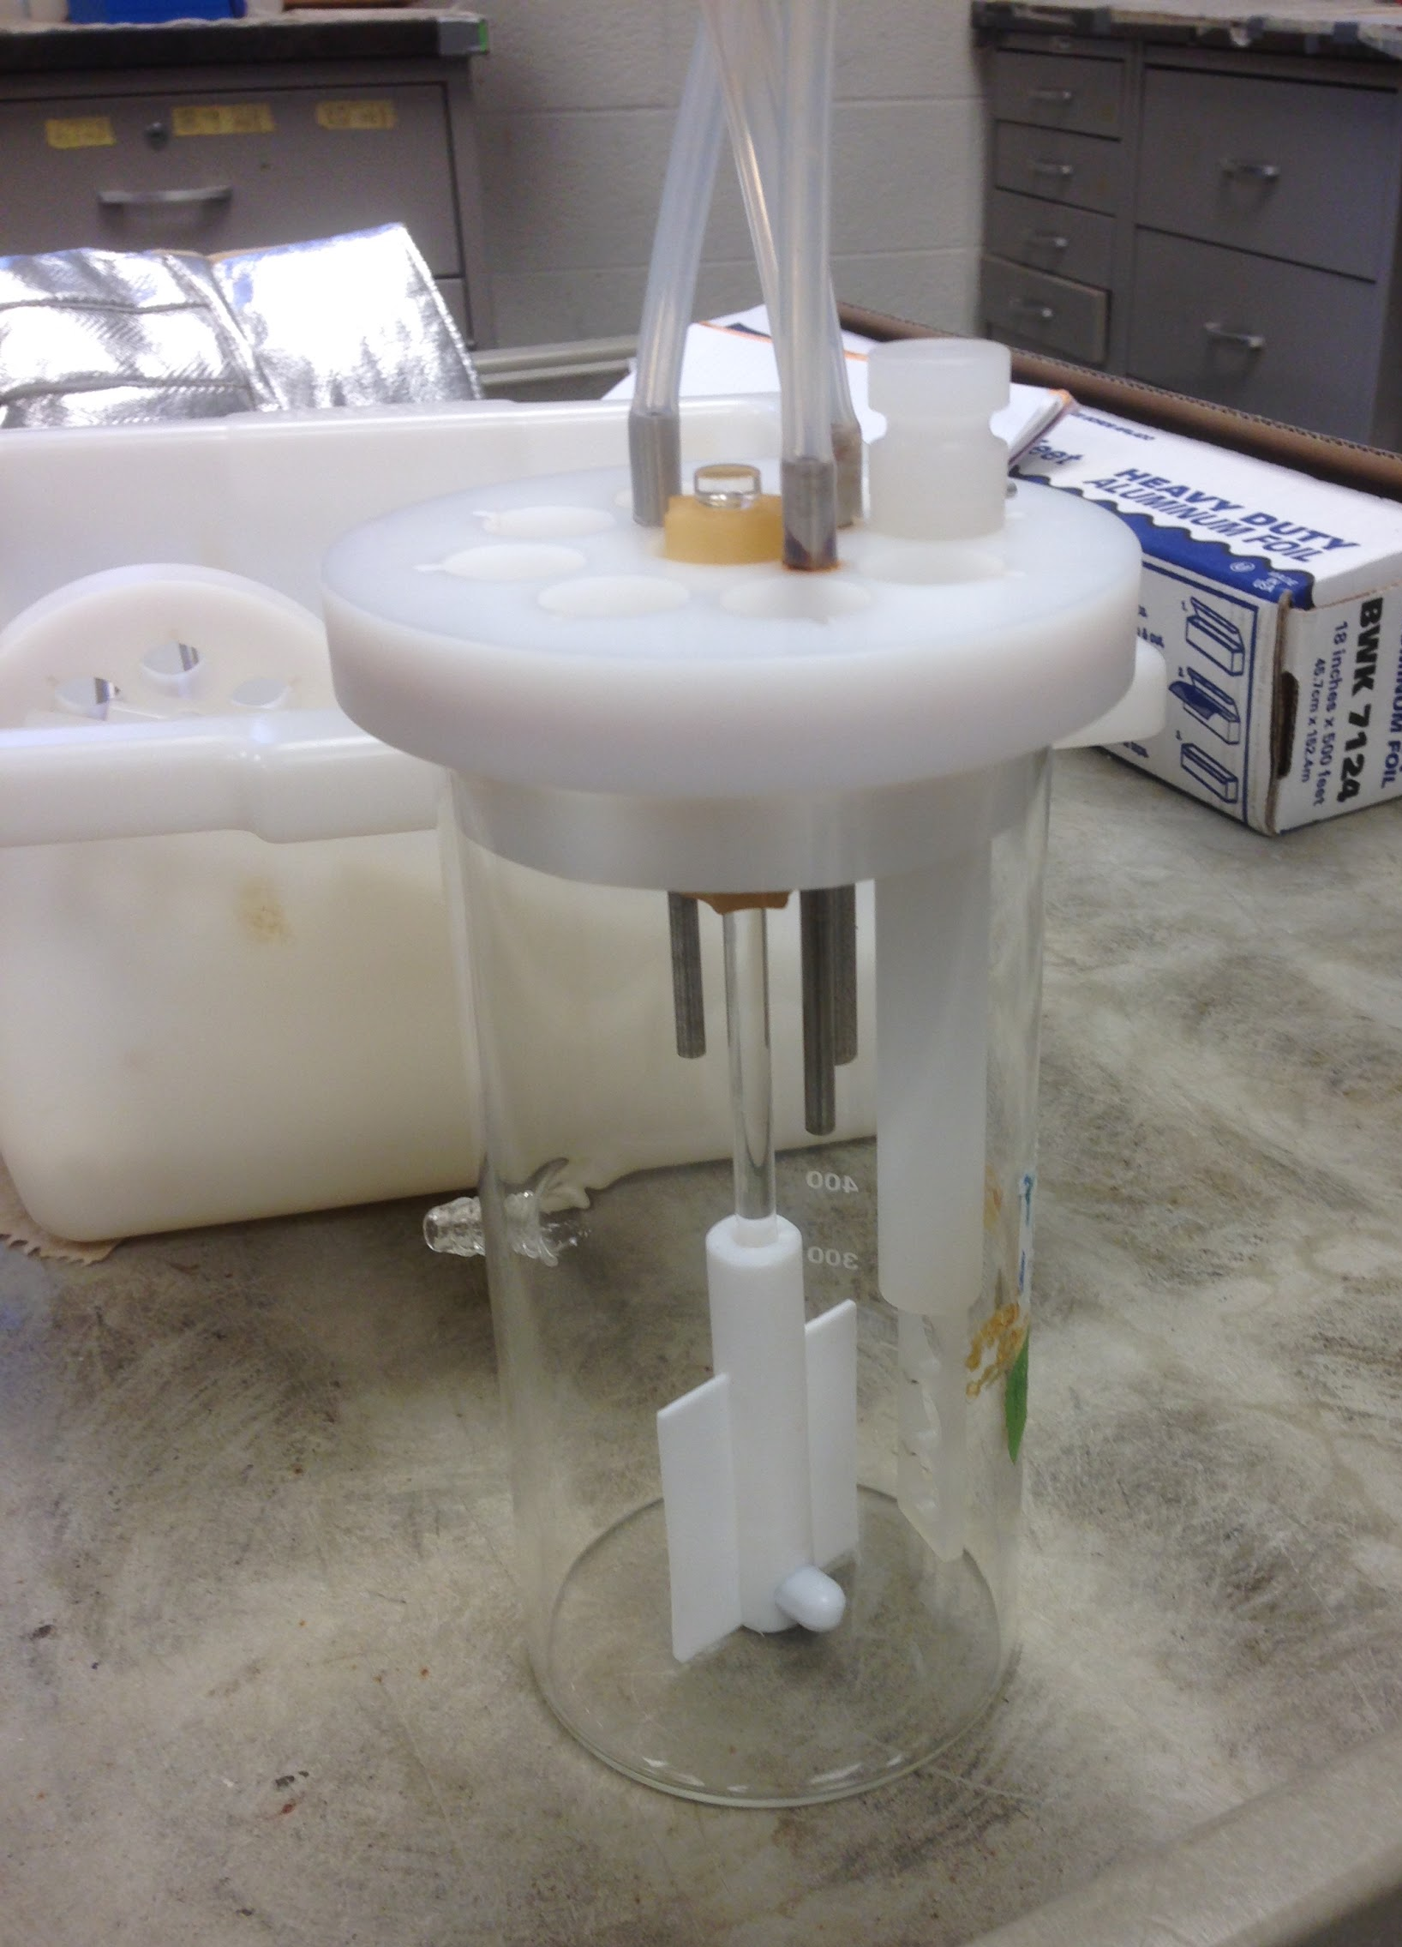
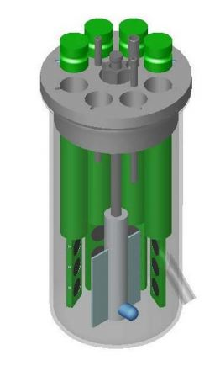
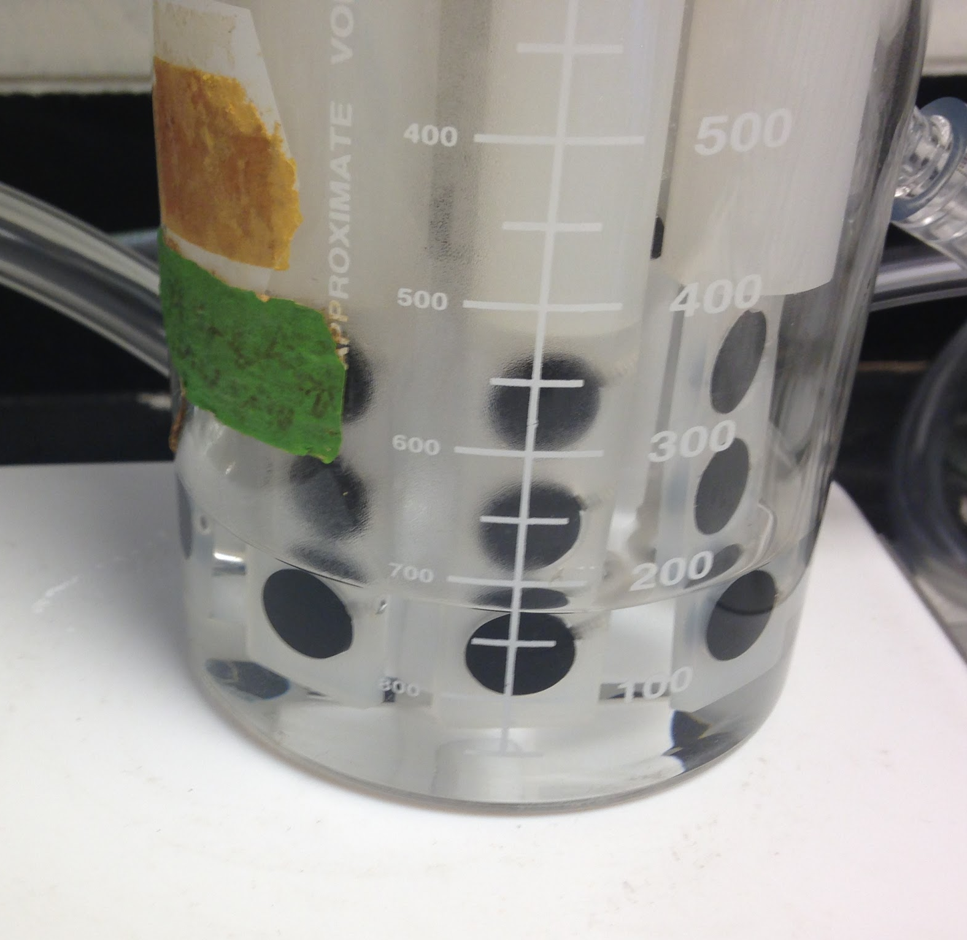
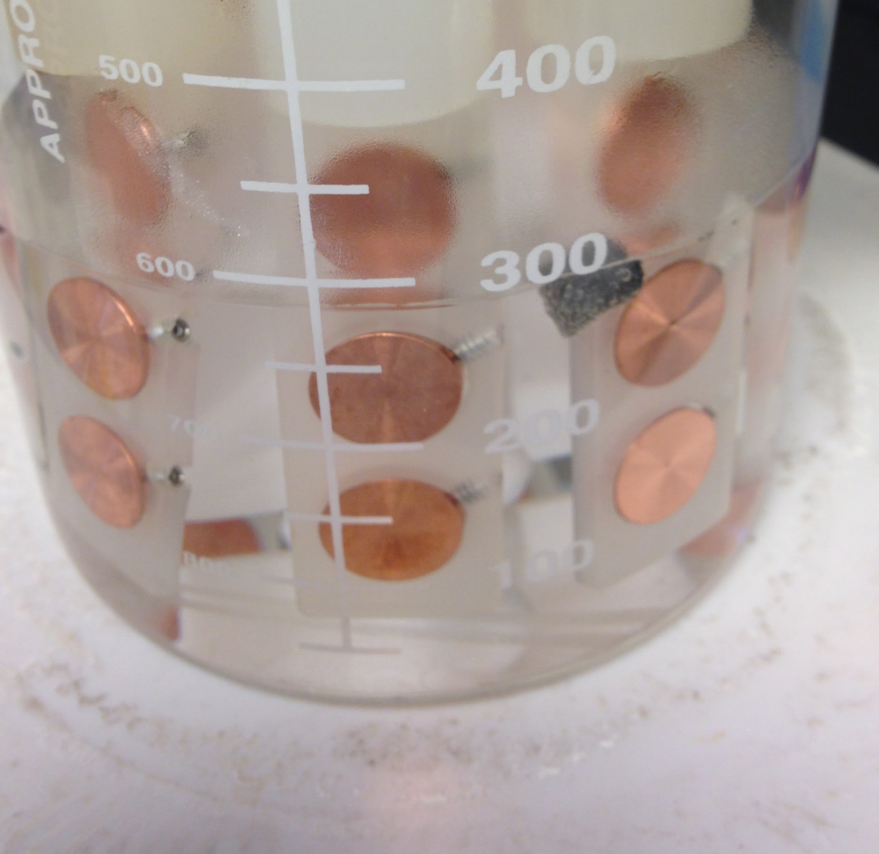
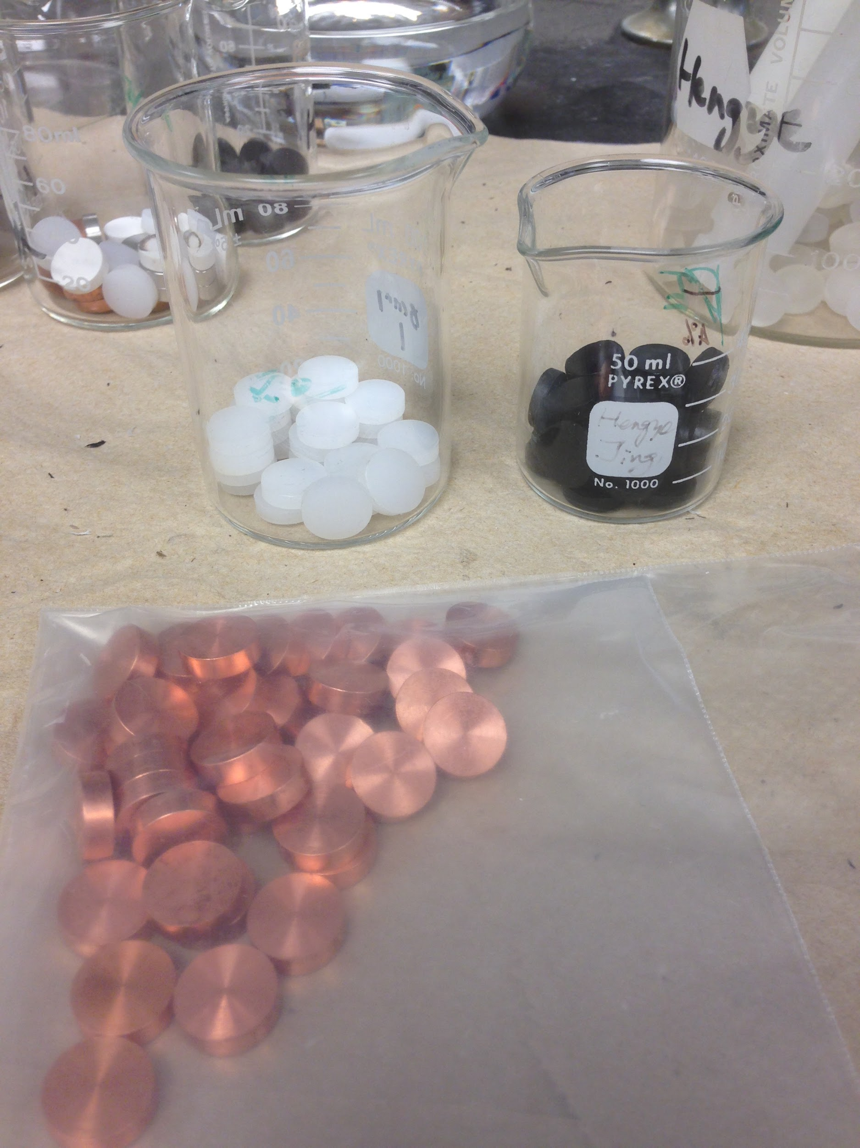
Research Training: Building the Biofilm Reactor
Coupon Rod
Securing the Coupons
Biofilm Reactor
Stirring Rod
www.researchgate.nett
PE-MWCNTs Coupons
Copper Coupons
Coupons
Notes:
Start with the coupons, which are essentially the materials we are sampling. The two materials we used were copper and the nanocomposites.
Coupons were inserted into the coupon rods. The coupon rods were inserted into the biofilm reactor.

Slide 14
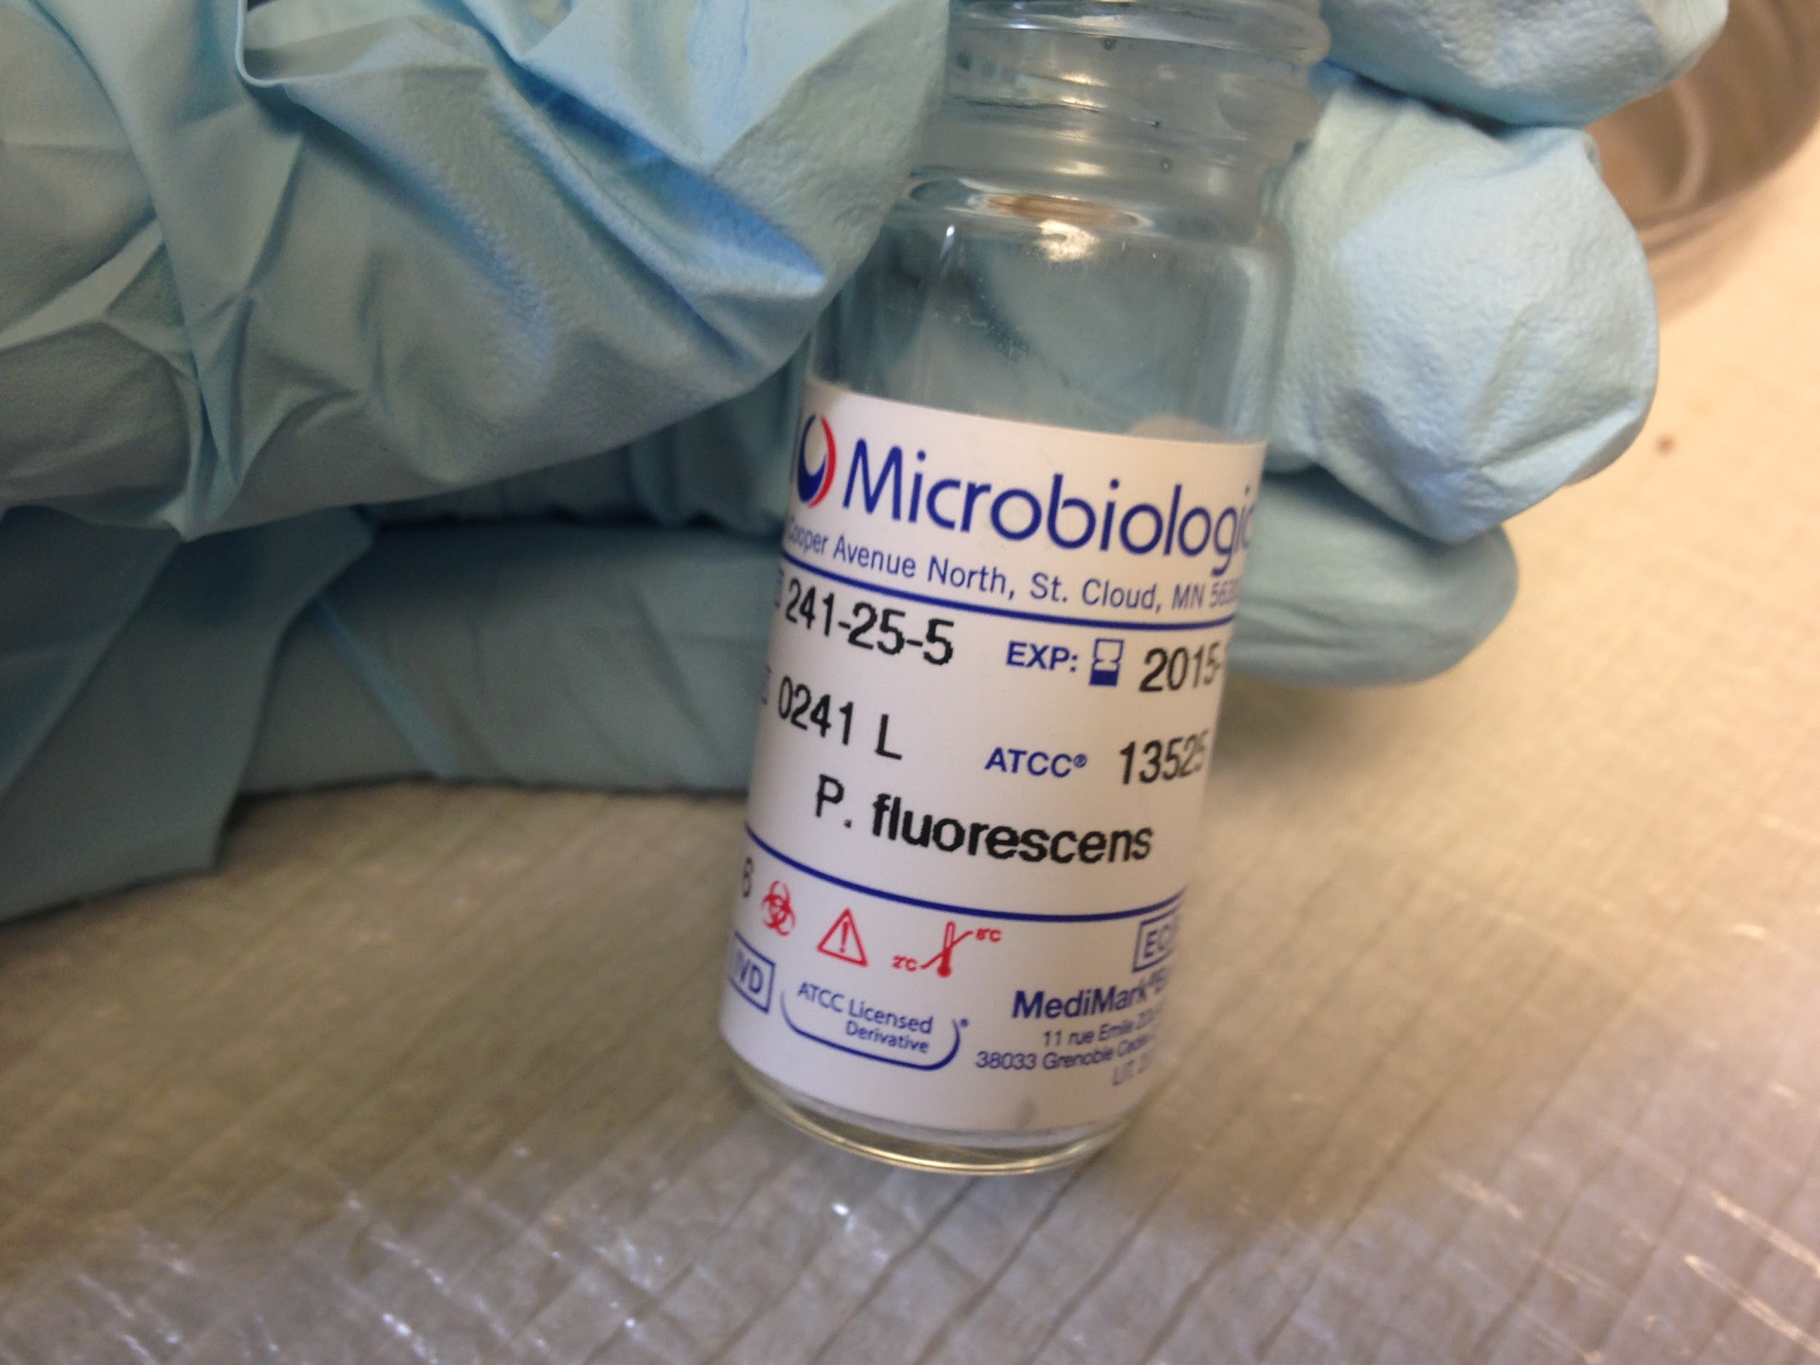
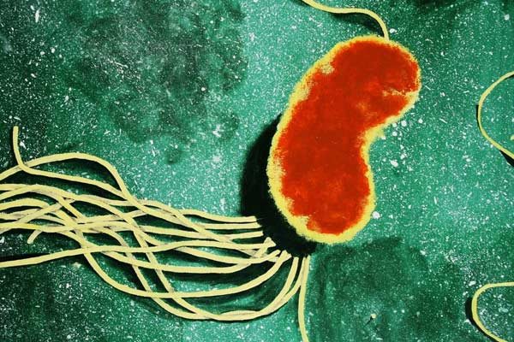
Adding Microbial Species
Microbial tablet of Pseudomonas fluorescens added to each reactor
Harmless biofilm
Excessively present in water distribution system.
http://organicsoiltechnology.com/wp-content/uploads/pseudomonas-fluorescens-makes-phosphorus-availabl-1.jpg
Notes:
Pseudomonas fluorescens was added to the biofilm reactor because it is harmless and commonly found in water distribution systems.

Slide 15
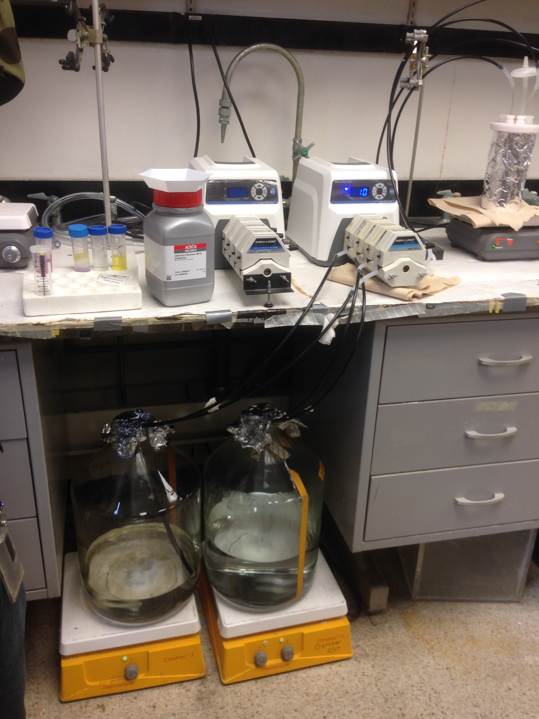
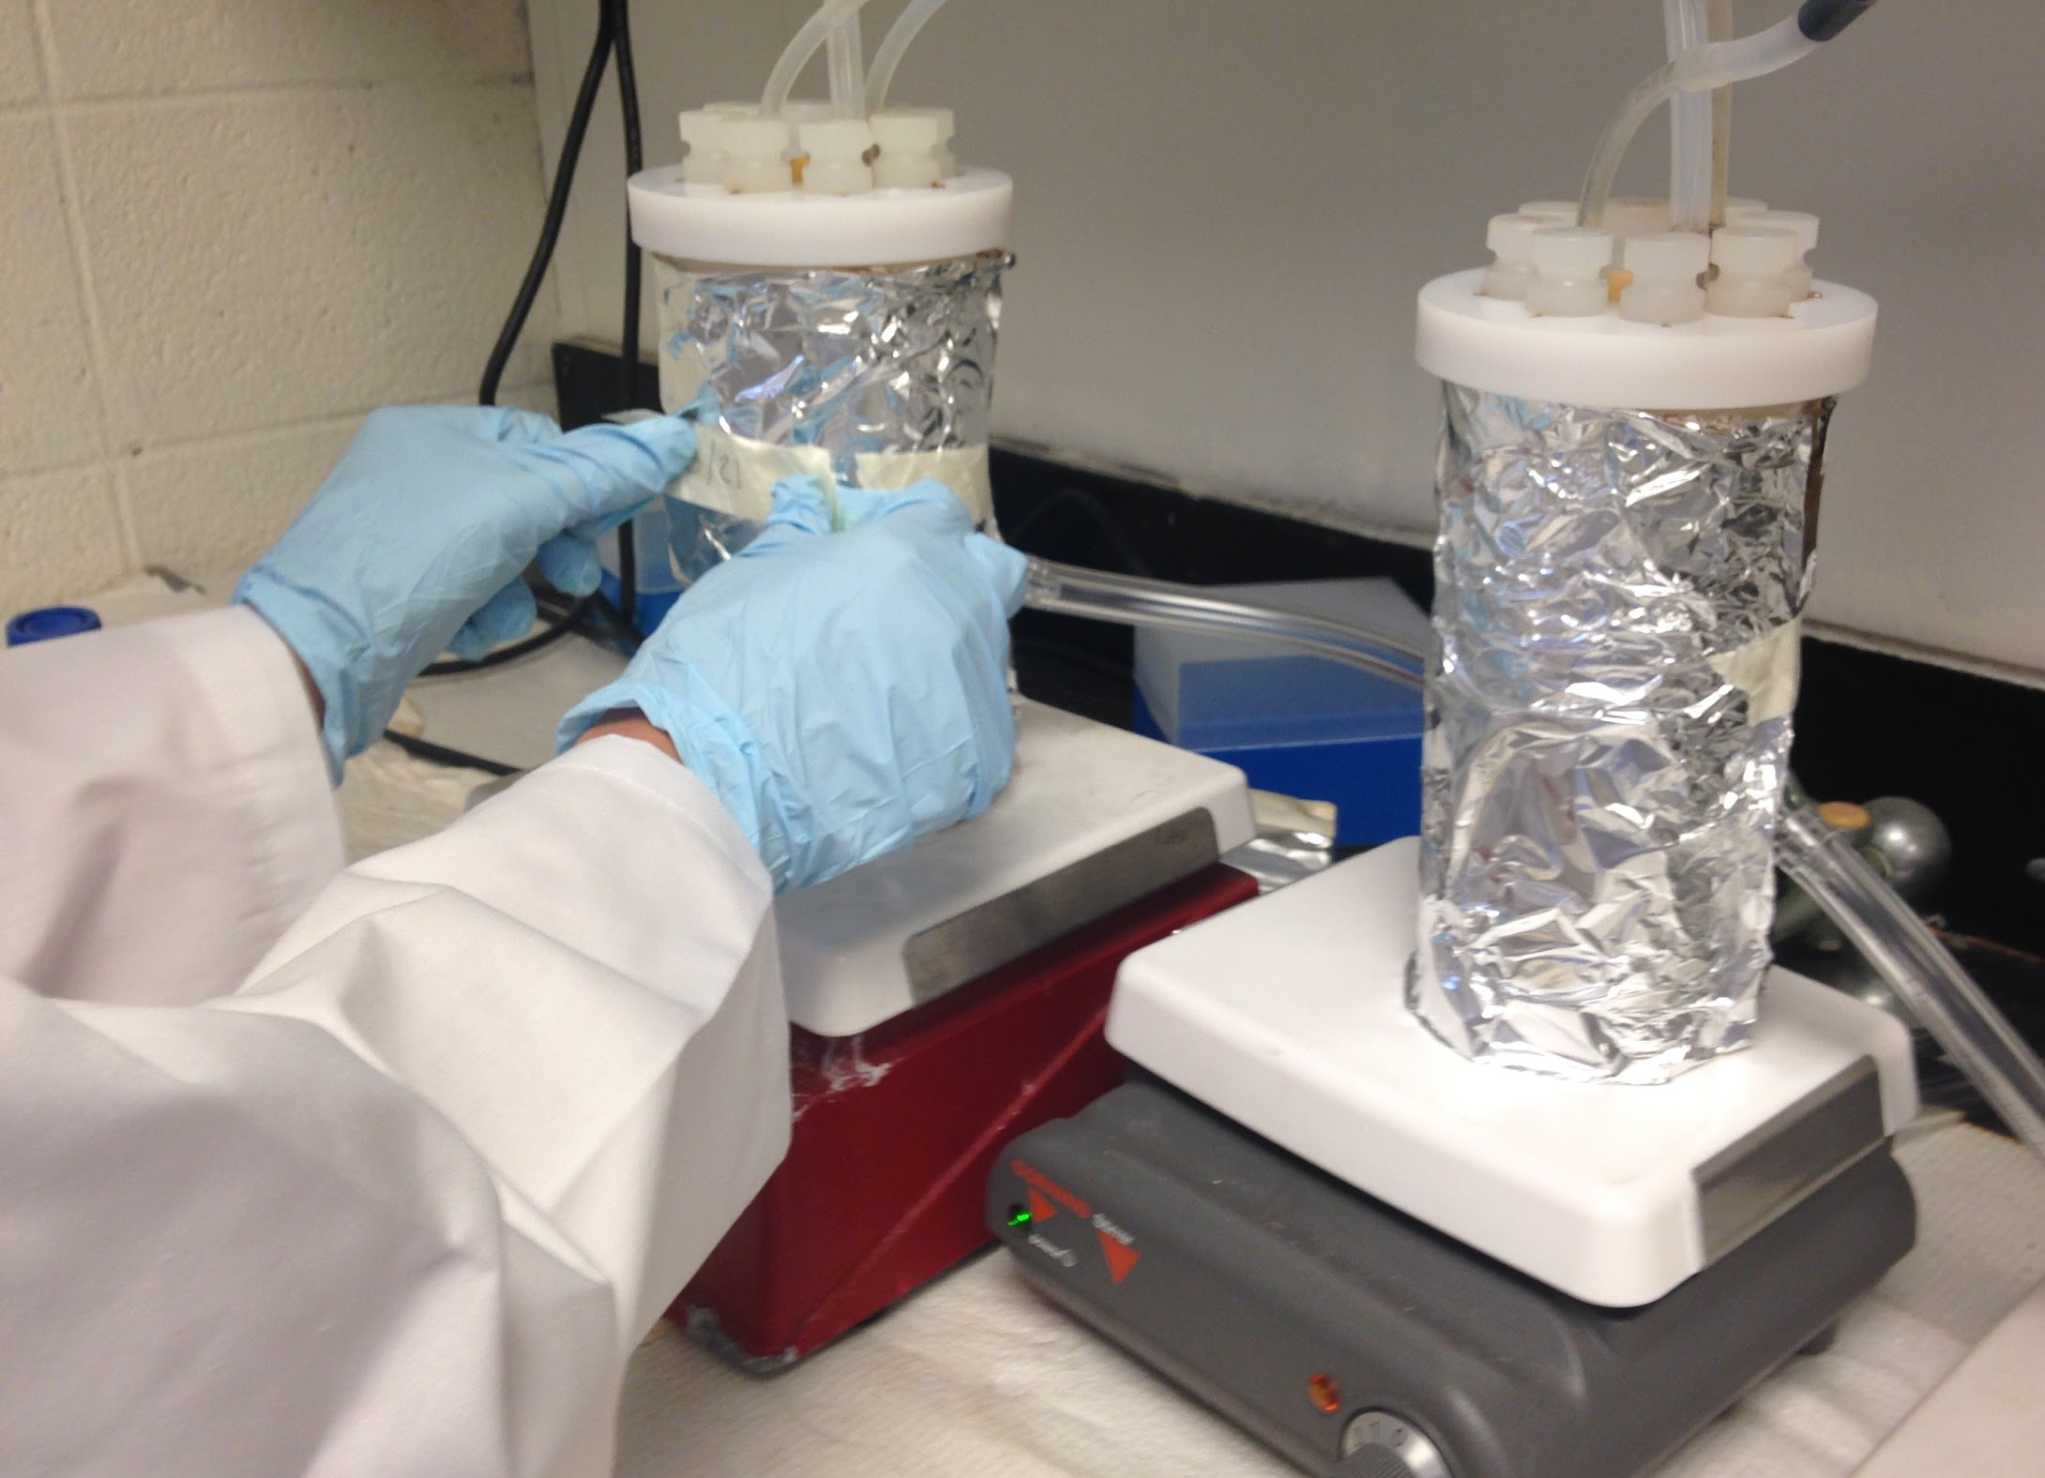
Nutrient Solution
Nutrient stock solution containing mainly NaNO₃ and NaH₂PO₄
Nutrient Carbon Source - Glucose
Fed to the biofilm reactor using peristaltic pump
pH of 7.5, maintained with NaHCO₃
Room temperature 25 ̊C
“Food” for the microbials
Notes:
A nutrient solution was added as “food” for the microbials. The Nutrient stock contained mainly nitrates, phosphates, and a carbon source. The carbon source was mainly glucose. The pH was maintained at 7.5 with a buffere solution and the room temperature was kept at 25 degrees celcius.

Slide 16
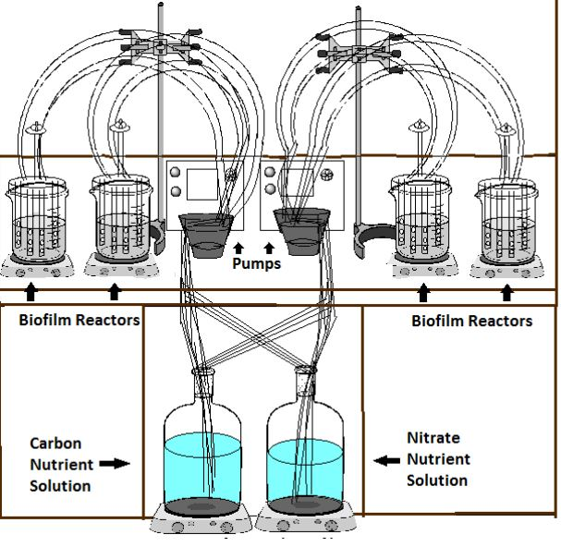
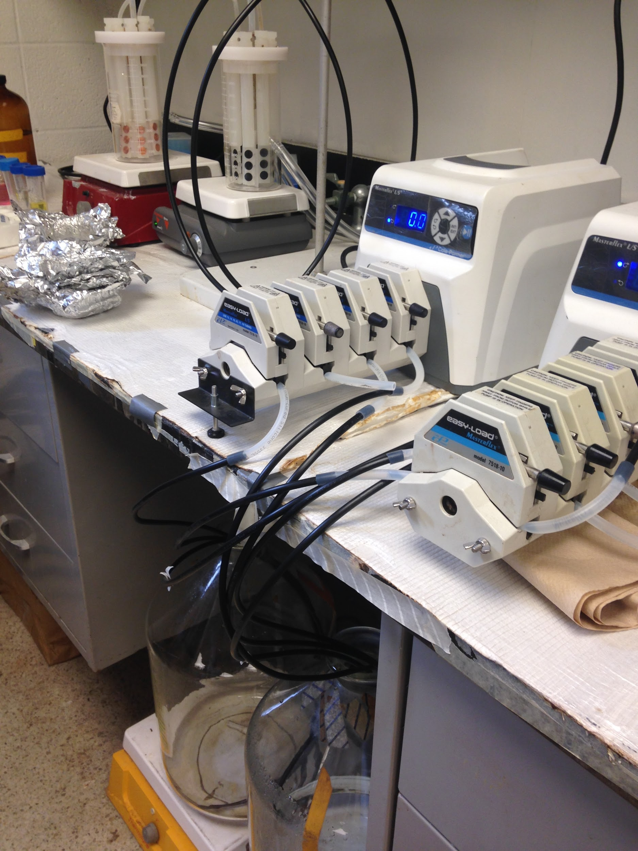
Complete Reactor Setup

Slide 17
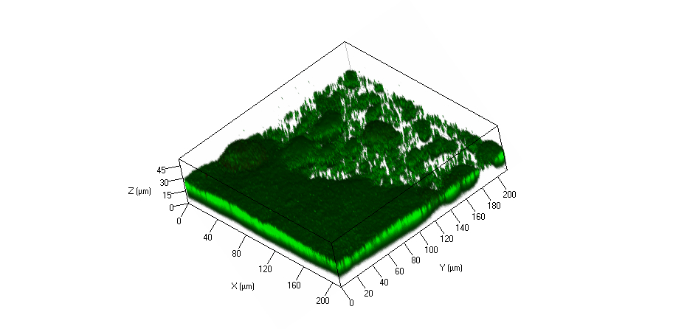
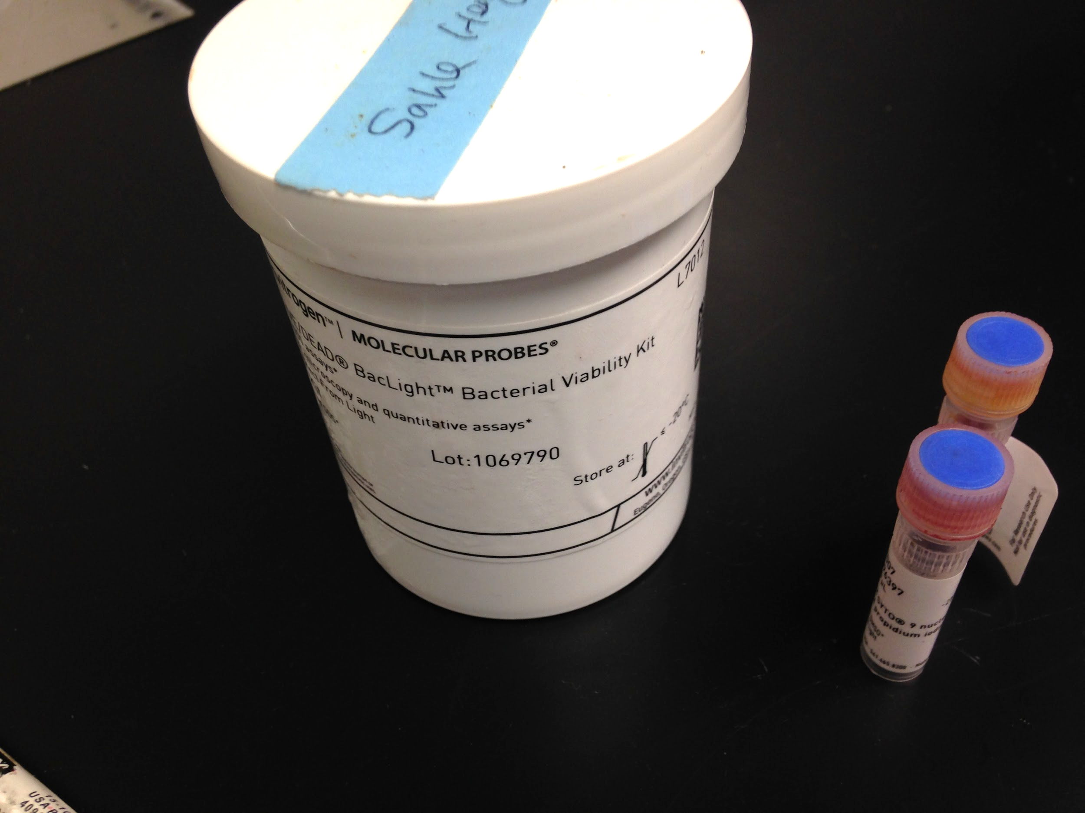
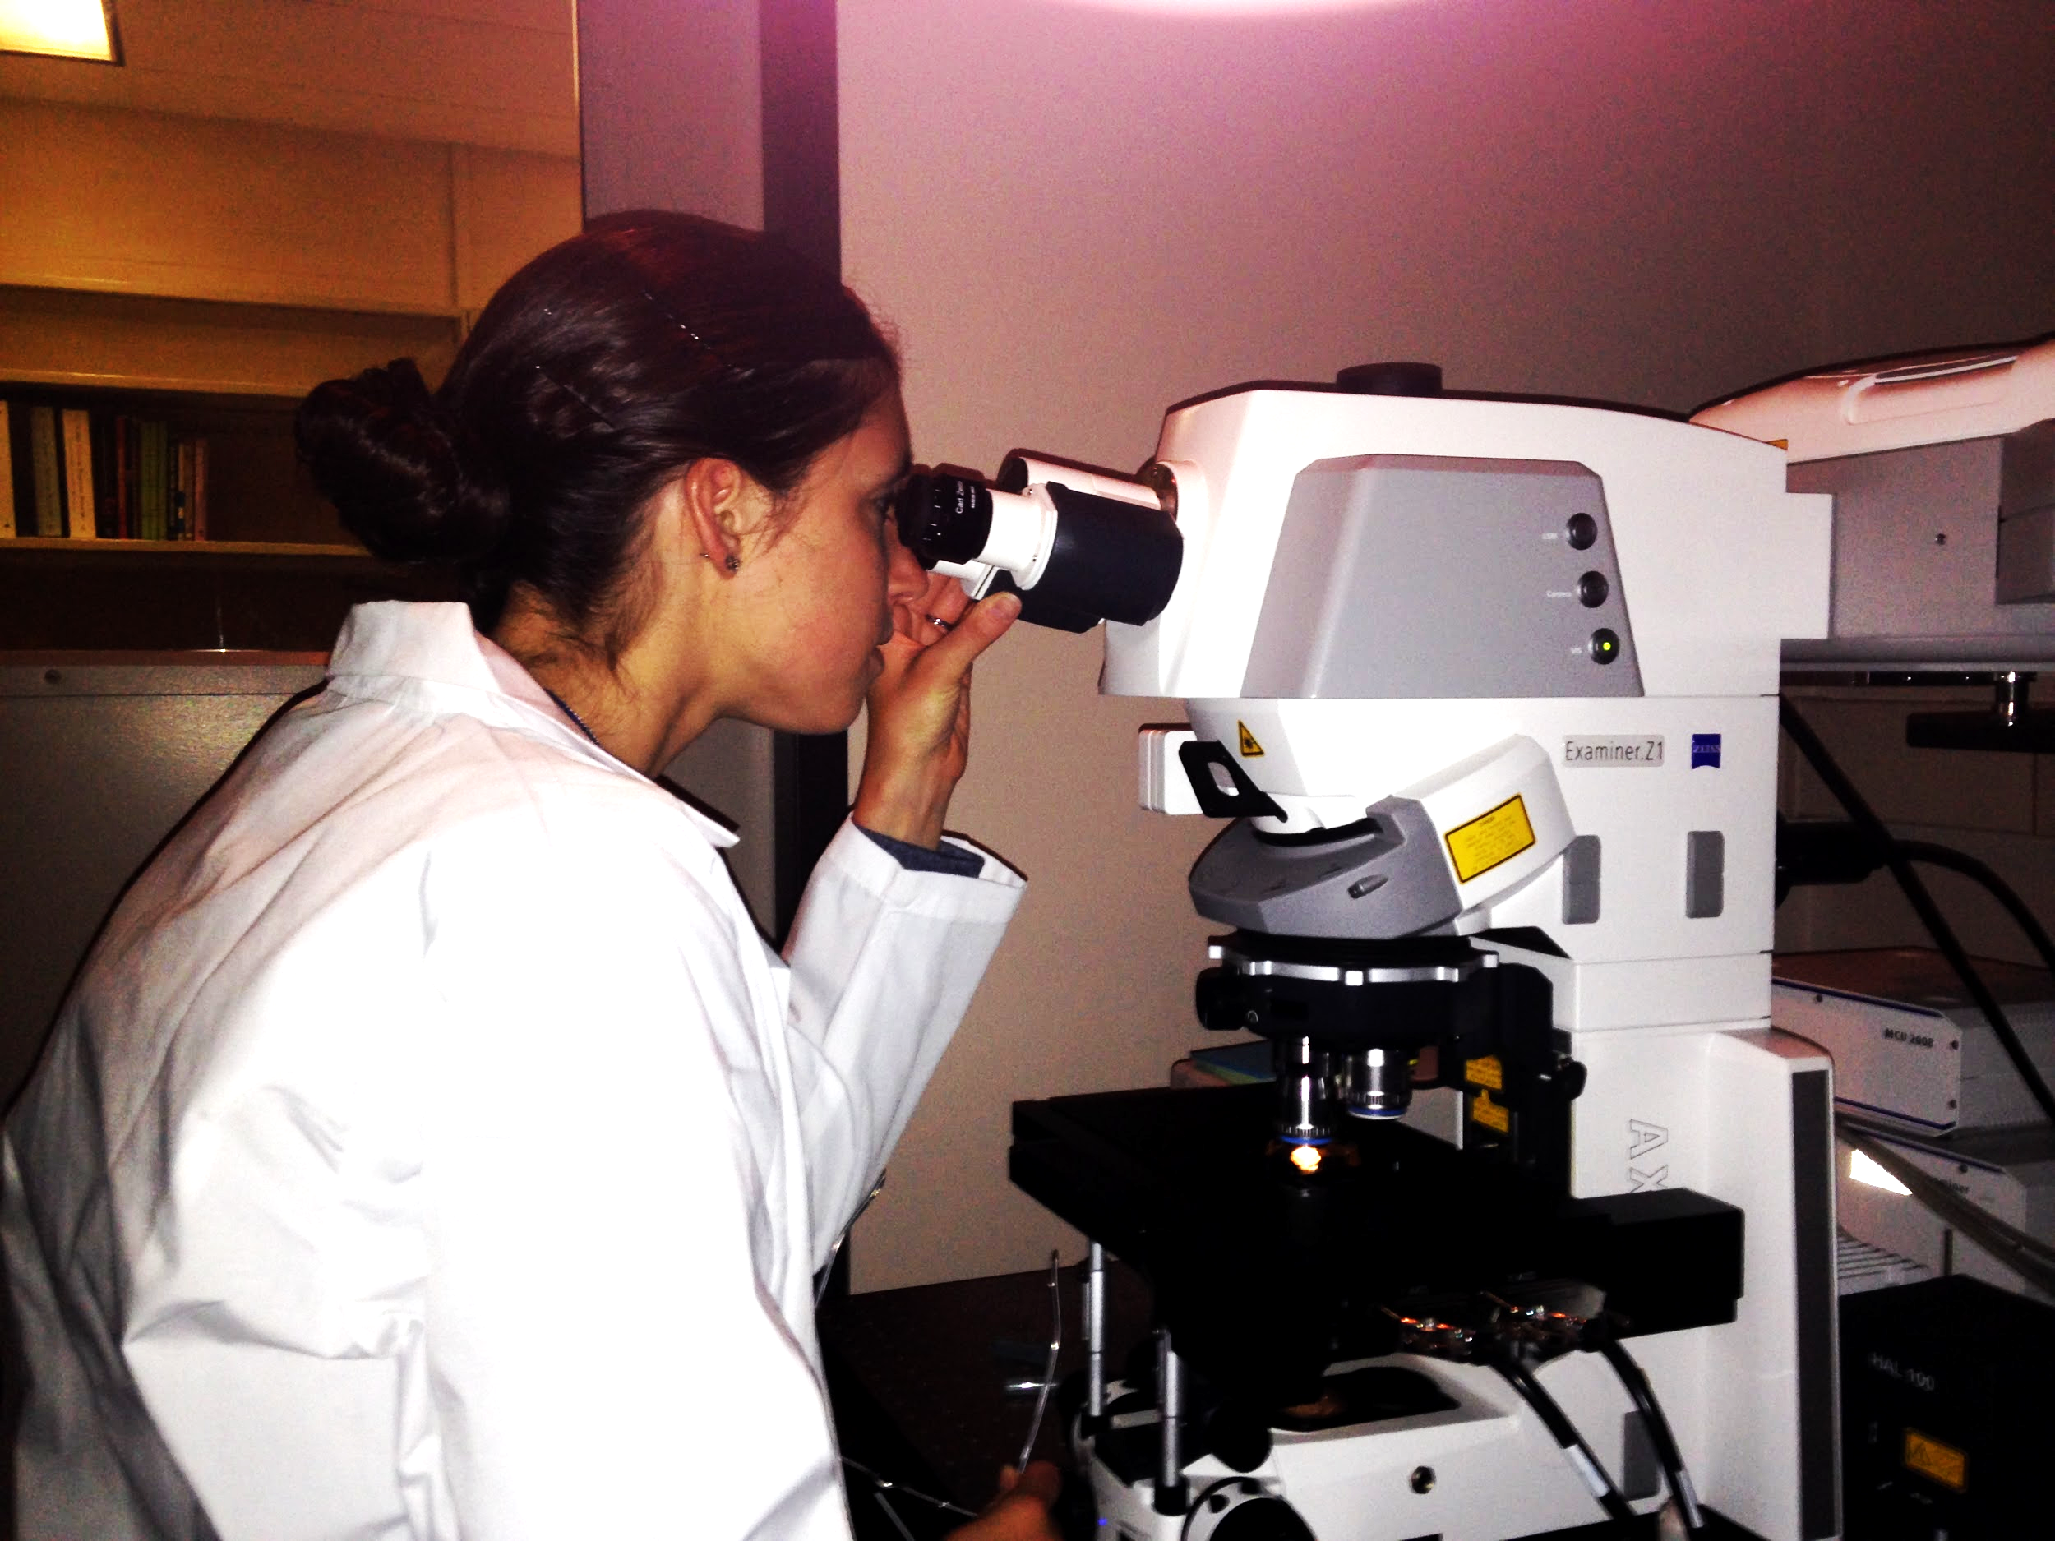
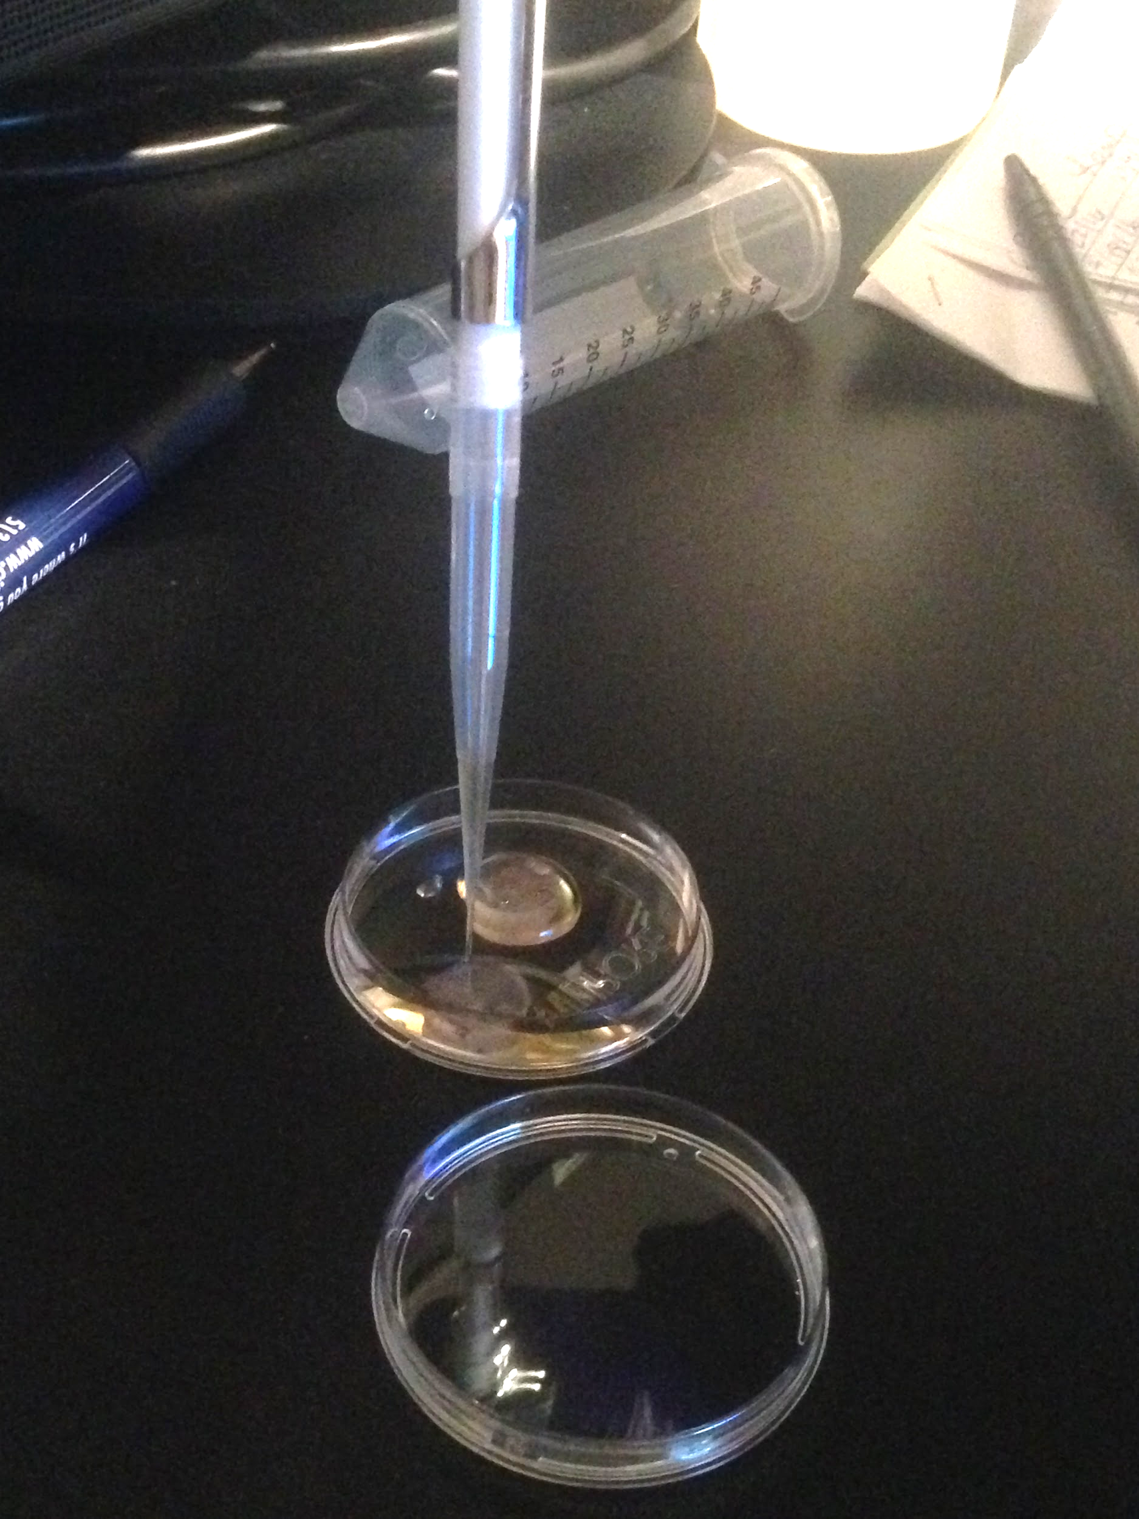
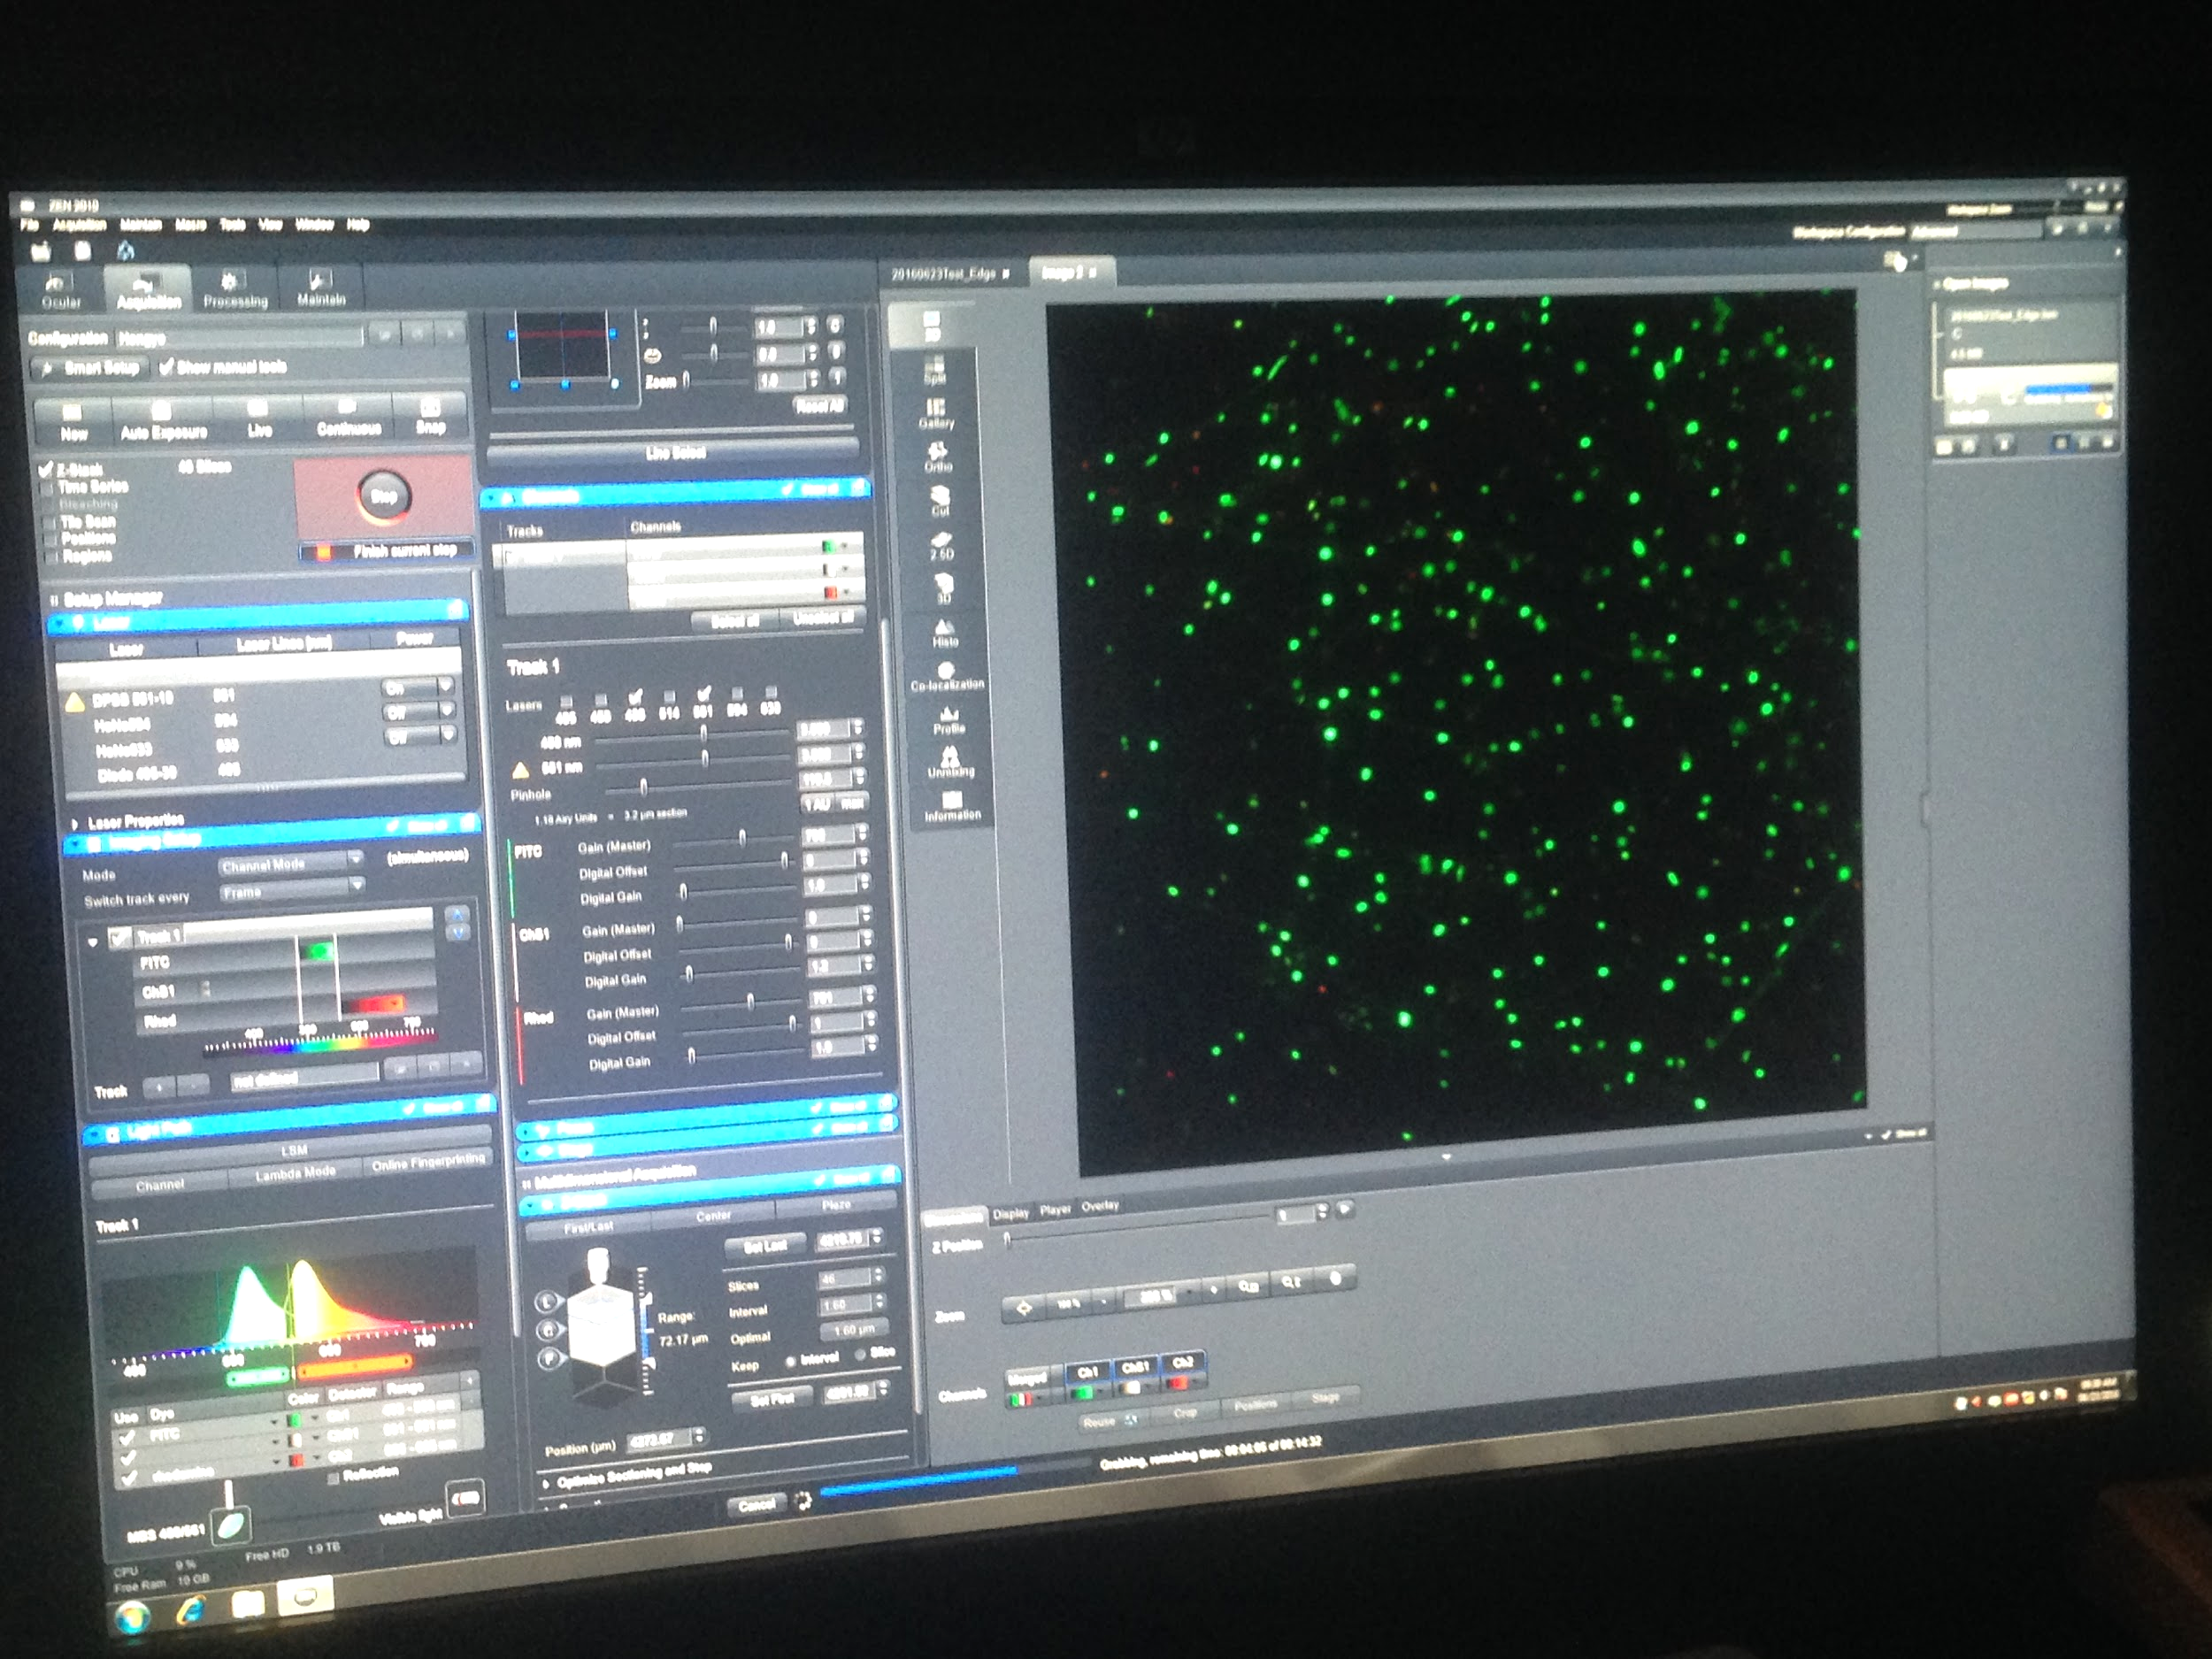
Data Collection with LSM
1. LIVE/DEAD® Stain for Biofilm Viability
5. 3D Biofilm image
3. Laser Scanning Microscope
2. Stain the coupons
for 15 minutes
4. Image on computer monitor
Notes:
Located at the EPA. Describe the process of mixing the dye with the DI water and pipetting it onto the biofilm. Let sit for 15 minutes, then examine using the LSM.

Slide 18
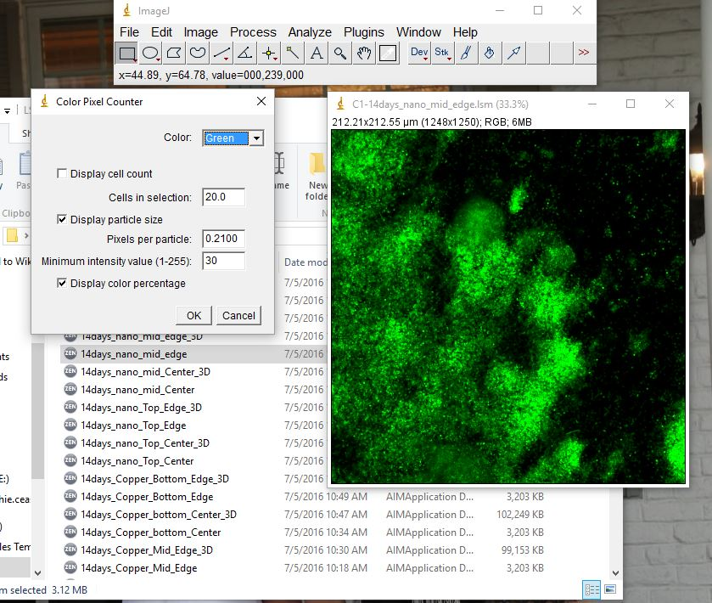
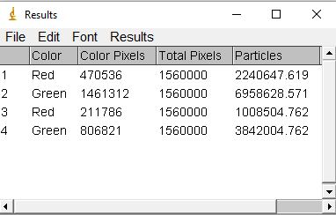
Biofilm Growth Quantification
Bacteria cells are quantified using ImageJ software
Progress:
7 days
14 days
20 days
27 days

Slide 19
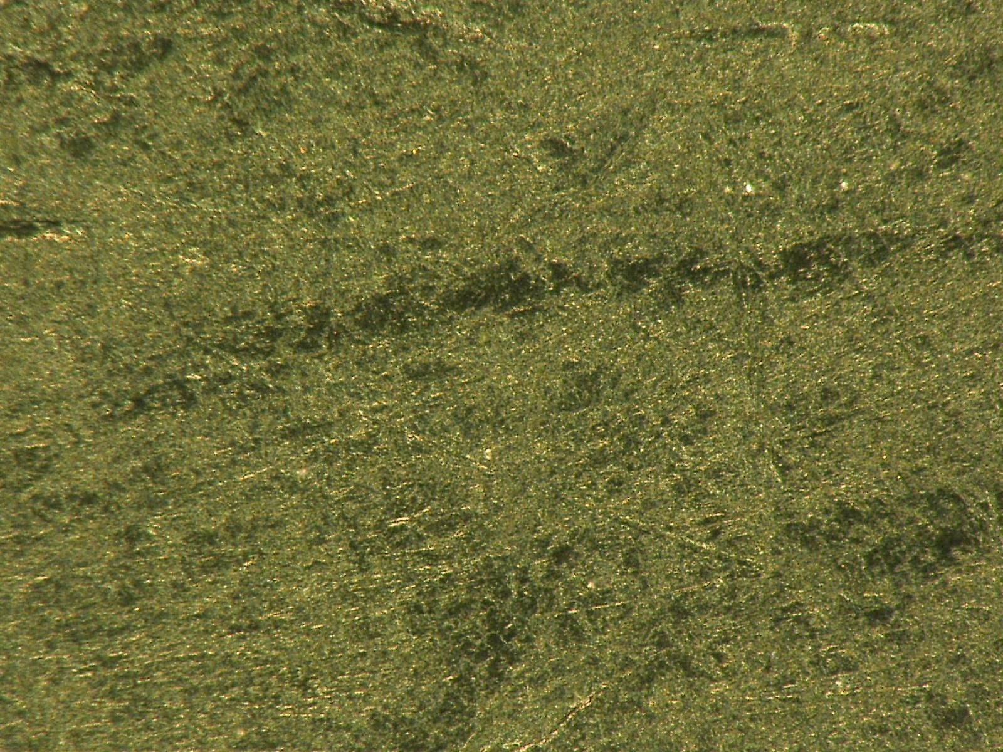
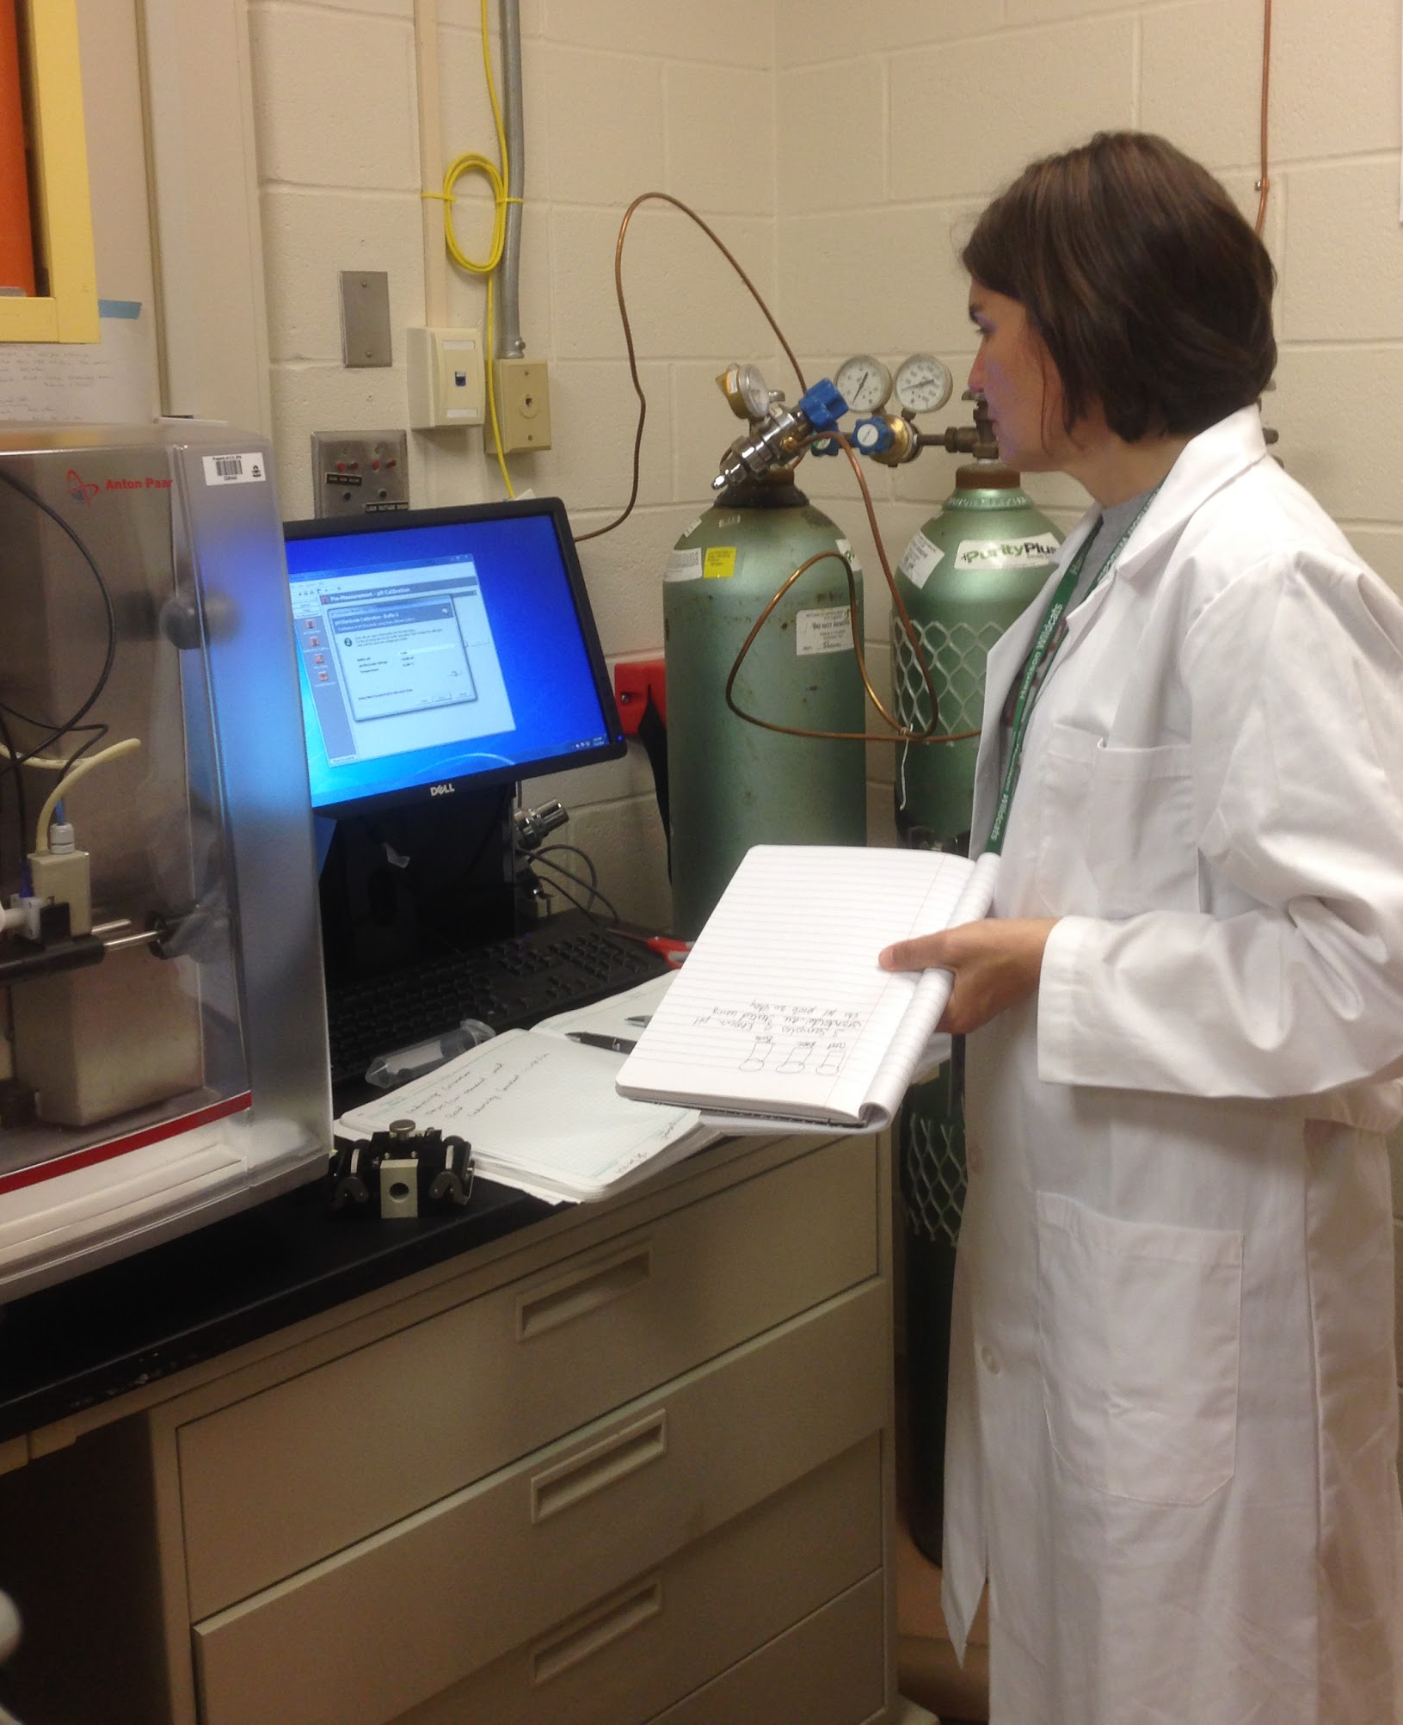
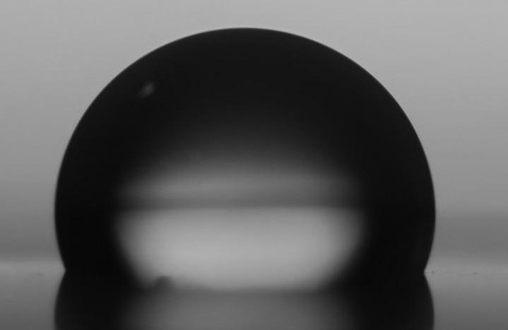
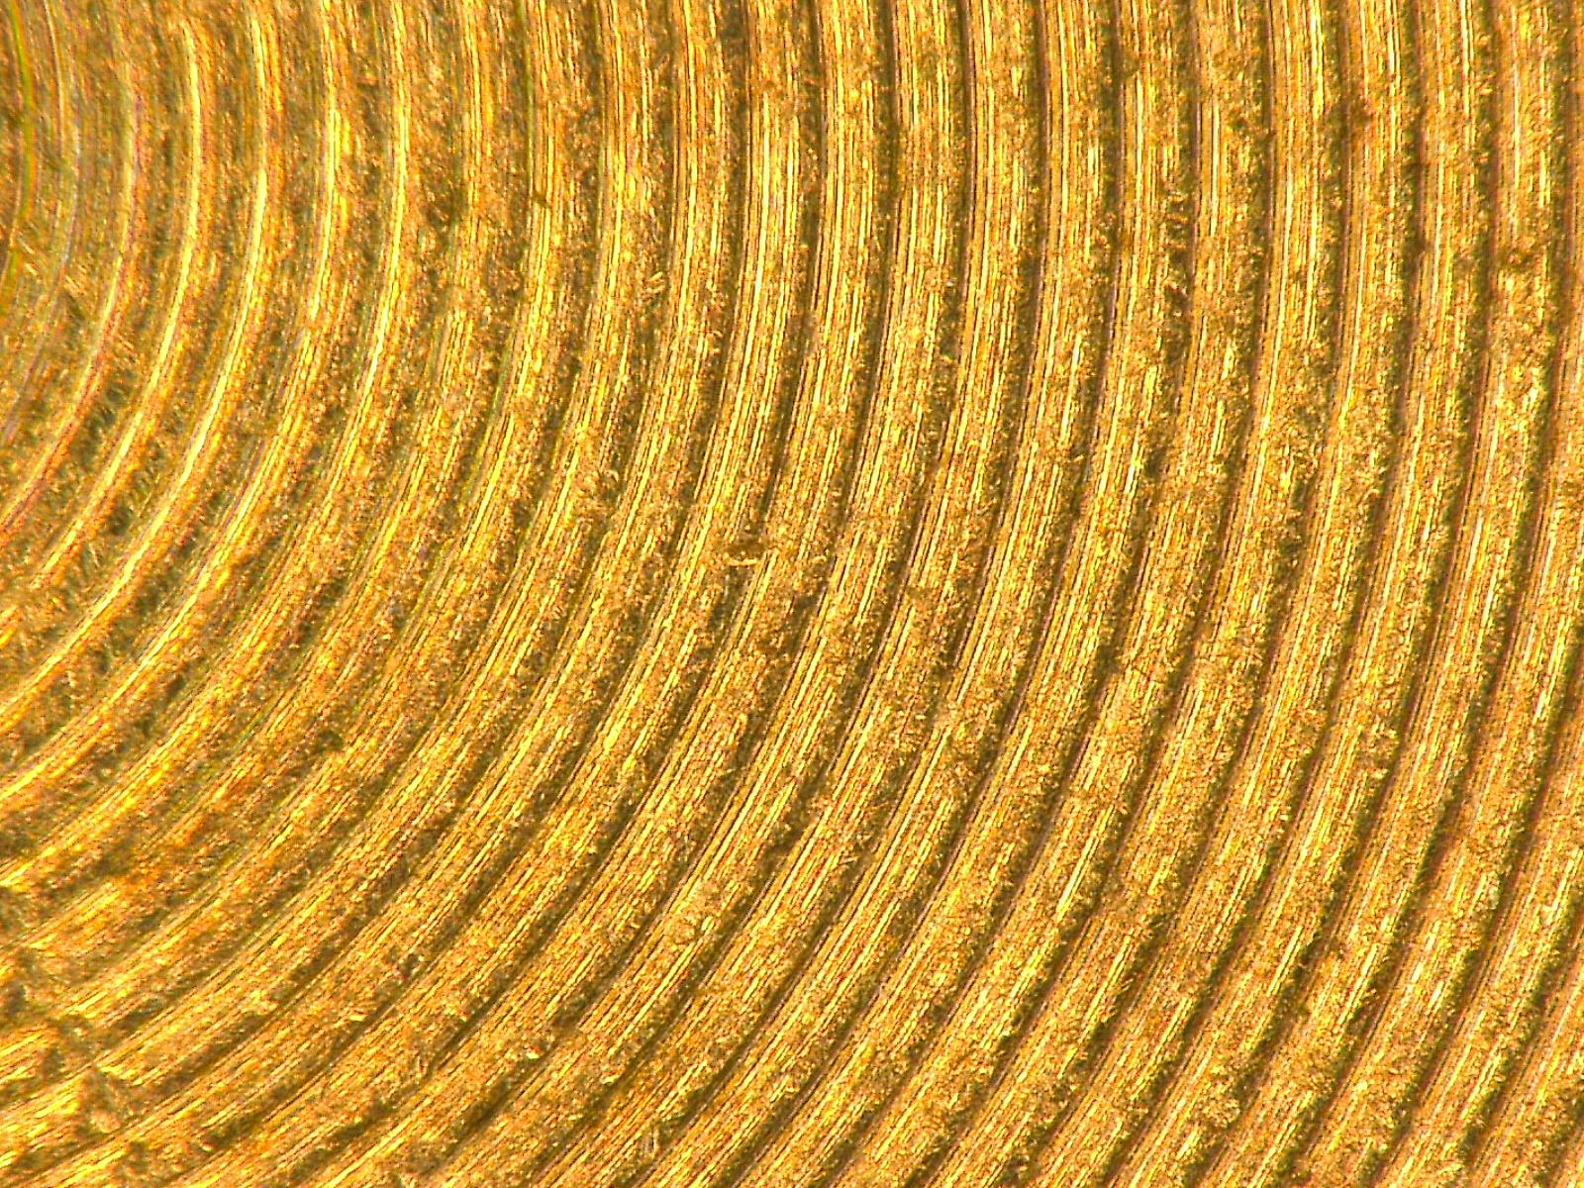
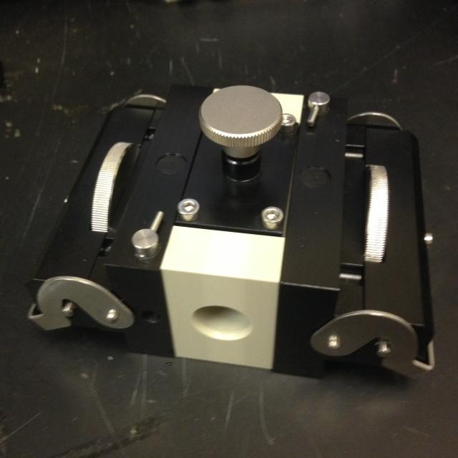
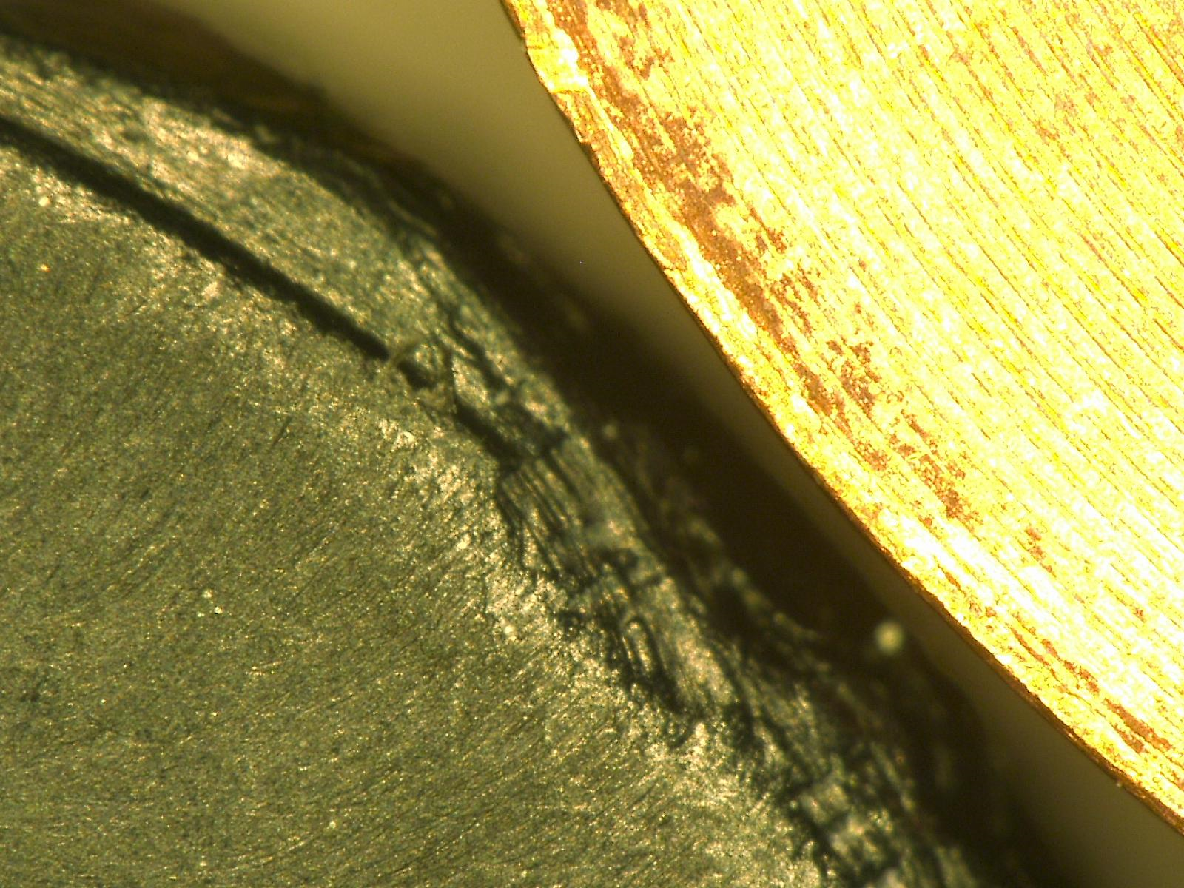
Surface Property Analysis
Surface Roughness
Hydrophobic vs. Hydrophilic
Zeta-Potential
Nano 200x
Copper 200x

Slide 20
Surface Properties of Copper and PE-MWNCTs Nanocomposites
Test | Copper | PE-MWNCTs
Contact Angle | 103.20° | 95.9°
Zeta Potential | -3.04 mV | -43.10 mV
Surface Roughness | 101.0 μm (Center) 115.7 μm (Edge) | 33.8 μm (Center) 68.6 μm (Edge)
Notes:
When data was analyzed in JMP with the biofilm data, Only major factor was surface roughness.
“Amy will discuss what we learned from our research….”

Slide 21
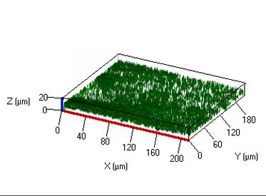
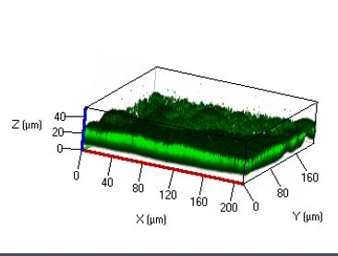
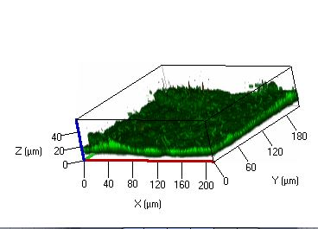
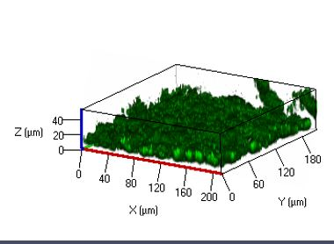
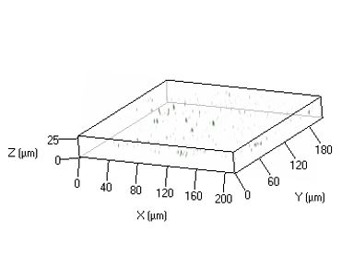
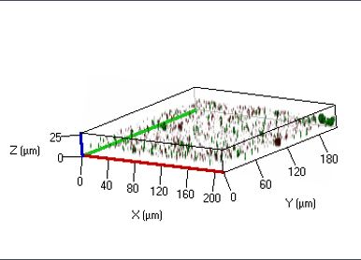
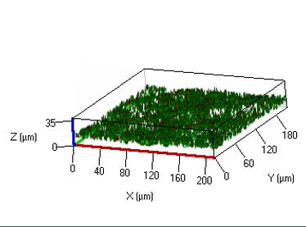
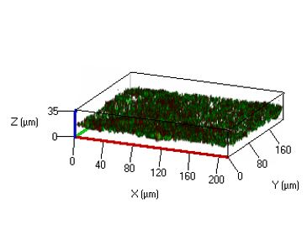
BIOFILM GROWTH ON NANOCOMPOSITES
BIOFILM GROWTH ON COPPER
7 Days
14 Days
20 Days
27 Days
Notes:
Amy Starts: When we compared the nano with copper, we saw that we got more growth on the nano than copper.

Slide 22
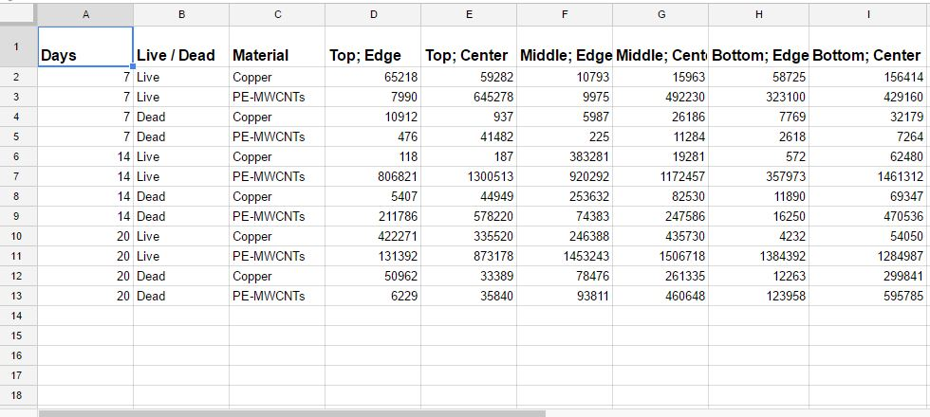
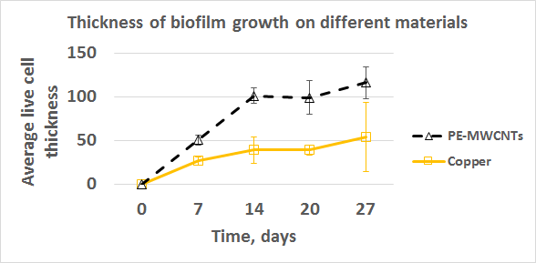
Data Analyzed Using JMP Ⓡ
Notes:
If we take sections of the Z-stack and counted actual number of slices from pics., it was clear that biofilm growth on the Nano was thicker.
Not what we expected, but future research is needed….

Slide 23
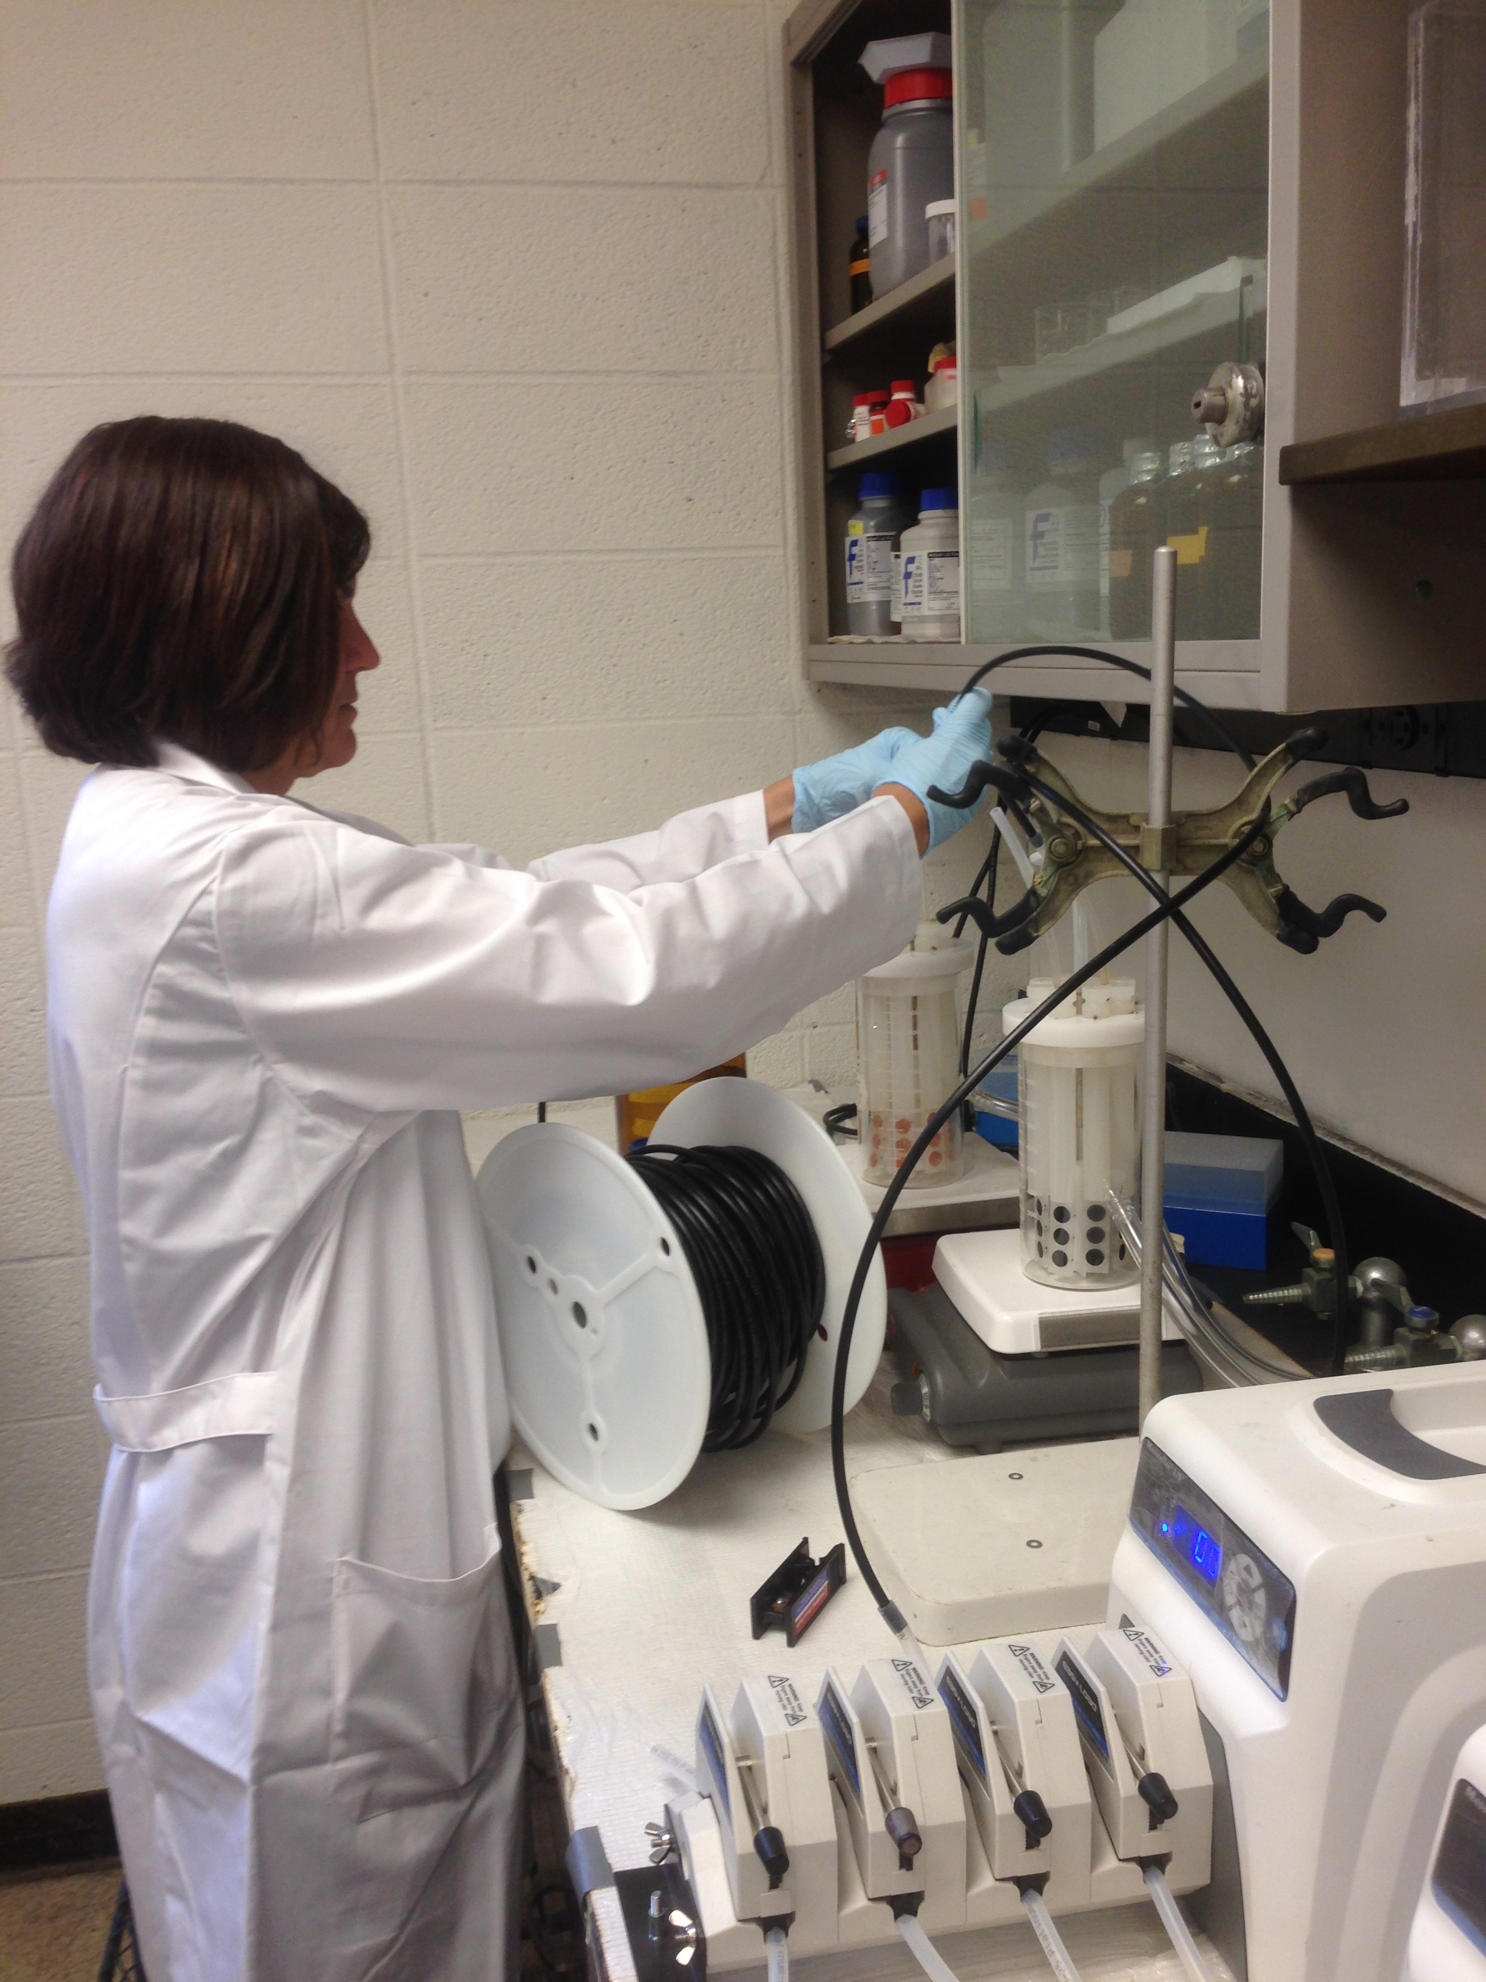
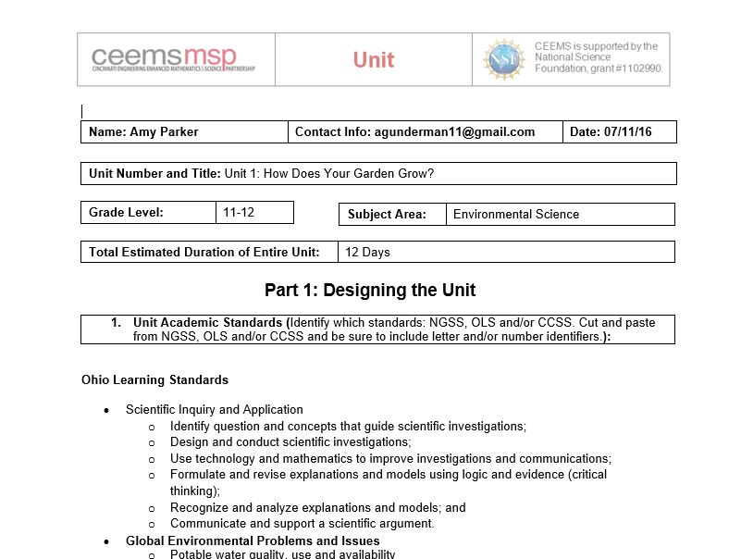
Goal Execution
G1. Biofilm impact
G2. Nanomaterials in biofilm prevention
G3. Academic research and today’s Classroom

Slide 24
Amy Parker’s Unit Progress
Big Idea: Water Transportation/ distribution
Essential Question: How do we efficiently and sustainably transport water to where it is needed for agriculture purposes?
http://cdn.phys.org/newman/gfx/news/hires/2009/waterconserv.jpg
www.civileblog.com
blogs.oxfam.org

Slide 25
Standards and Research Connection?
Connection to Scientific Inquiry and Application
Communicate and support argument
Environmental Science standards
Importance of water
Water transportation
Agriculture
Food production
www.guardian.co.tt

Slide 26
The Challenge
Design and build a way to transport enough water to water the new community garden to ensure plant growth.
Limitations:
Time
Cost
Water sources
Water amount
Notes:
Nancy will now explain her unit…”

Slide 27
Nancy Vossen’s Unit Progress
Topic: Clean Water
Essential Question:
How can pollutants be removed from water?
www.fiboni.com

Slide 28
Nancy: Standards and Research Connection
Interdependence of living organisms
Clean water is vital to the survival of all living things
http://blogs.rj.org/rac/files/2013/10/clean-water-act.jpg

Slide 29
Nancy: The Challenge
Challenge: Design a Water Filtration System that can used to filter enough drinking water for one day. (2000ml)
Limitations:
Use only household products
Completed in 2 class periods
www.cleanwaternm.com

Slide 30
References
Cantor, A. F. (2003). "Effect of chlorine on corrosion in drinking water systems." Journal - American Water Works Association, 95(5), 112; 112-122; 122
Flemming, H., and Wingender, J. (2010). "The biofilm matrix." Nature Reviews Microbiology, 8(9), 623-633.
Kostakioti, M., Kostakioti, M., Hadjifrangiskou, M., and Hultgren, S. (2004). "Bacterial Biofilms: Development, Dispersal, and Therapeutic Strategies in the Dawn of the Postantibiotic Era." Cold Spring Harbor Perspectives in Medicine, 3(4), a010306; a010306-a010306; a010306.
Parandhaman, T., Das, A., Ramalingam, B., Samanta, D., Sastry, T. P., Mandal, A. B., and Das, S. K. (2015). "Antimicrobial behavior of biosynthesized silica–silver nanocomposite for water disinfection: A mechanistic perspective." J.Hazard.Mater., 290 117-126.
Percival, S. L., Walker, J. T., and Hunter, P. R. (2000). Microbiological aspects of biofilms and drinking water. CRC Press, Boca Raton.
Renner, L. D., and Weibel, D. B. (2011). "Physicochemical regulation of biofilm formation." MRS Bull, 36(5), 347-355.
Thuptimdang, P., Limpiyakorn, T., McEvoy, J., Prüß, B. M., and Khan, E. (2015). "Effect of silver nanoparticles on Pseudomonas putida biofilms at different stages of maturity." J.Hazard.Mater., 290 127-133.
Zheng, M. (12). "Fate of free chlorine in drinking water during distribution in premise plumbing." Ecotoxicology (London), 24(10), 2151; 2151-2155; 2155.

Slide 31
The RET program funded by the National Science Foundation, Grant ID# EEC-1404766
Project Faculty Mentor, Dr. George Sorial and Dr. Margaret J. Kupferle
Graduate Research Assistant, Mr. Hengye Jing
RET Project Director and Principal Investigator, Dr. Anant R. Kukreti
Resource Person & Grant Coordinator, Debbie Liberi
RET Resource Teacher, David Macmorine

